Slide 1

Watershed Bounded Network Model WBNM2017
Workshop November 2017
Novatel Wollongong NSW
E H (Ted) Rigby

Slide 2
WBNM 2017---------------------------------PROGRAM
Welcome and Administration
Background to WBNM
WBNM2017 Overview
WBNM Release Packages
Morning Tea
Basic Useage - wbnm2017
Lunch
Advanced Useage – wbnm2017
Afternoon Tea
Future Development & Support
Open Forum
E Rigby Nov 2017

Slide 3
WBNM 2017---------------------------------Background
Sherman (1932) Basic Unit Hydrograph (USA)
Clark (1945) Intoduced Travel Time (USA)
Rockwood (1958) Introduced Subareas (USA)
Nash (1960) Linear Reservoirs (USA)
Laurenson (1964) Hydrographs (Australia)
Metcalf and Eddy (1971) SWMM (USA)
US ARMY (1973) HEC-1 (USA)
Laurenson and Mein (1974) RORT/RORB (Australia)
Boyd (1975) WBNM (Australia)
Goyen and Aitken (1976) RAFTS (Australia)
E Rigby Nov 2017

Slide 4
WBNM 2017---------------------------------Background
Boyd (1975) 150 lines Fortran 66 (Phd)
Boyd Pilgrim and Cordery (1979) 190 lines Fortran 66 (FOS)
Boyd Bates Pilgrim and Cordery (1987) 2,400 lines Fortran 77 (FOS)
Boyd Rigby and VanDrie (1994) 8,100 lines Fortran 77 (Freeware)
Boyd Rigby and VanDrie (2012) 21,000 lines Fortran 95 (FOS)
Rigby (2017) (WBNM_ENG) 15,000 lines Fortran 2003/8 (FOS)
Rigby (2017) (WBNM2017) 22,000 lines Fortran 2003/8 (Freeware)
E Rigby Nov 2017

Slide 5
WBNM 2017---------------------------------Background
1975 - Only Universities/Government had computers – Input by punched cards Electronic calculators not invented – All practioners used sliderules. Computer based simulations only available to a select few that mostly were programmers.
Today – Almost all engineers have access to computers and routinely use specialised software to undertake simulations, but only a few are also programmers. Software is, in any event, mostly only available compiled – we are now in the ‘black box’ era and need training in appropriate use of these packages. As complexity increases it is very easy for an inexperienced user to create a garbage in, garbage out, simulation and not be aware that it has occurred!
WBNM is backed by considerable published research and has always (optionally) provided extensive internal diagnostic logs to allow users to follow the processes involved and to sanity check intermediate results as well as final output. (Lecturing background of MJB). In addition it is backed by comprehensive documentation, not only on how to use the software, but how it operates internally.
E Rigby Nov 2017

Slide 6
WBNM 2017---------------------------------Overview
SO WHAT IS WBNM?
WBNM is a free, highly capable, Australian hydrology model
WBNM’s primary goal is to simulate runoff from rain falling on a catchment
WBNM includes impacts of urbanisation on flood behaviour
WBNM includes ARR87 and ARR16 Design Flood Estimation (DFE)
WBNM has extensive (optional) output options and diagnostics built in.
WBNM includes a summary QA report of model scope/results/warnings
E Rigby Nov 2017

Slide 7
WBNM 2017---------------------------------Overview
MODEL INPUTS
Basic inputs are;
Catchment topology (how subareas connect)
Surface characteristics of catchment overall (eg C, Implagfactor, (1-m), Qlinear)
Surface characteristics of each subarea (eg area, %imp, legacy lags)
Routing protocol for stream in each non-head subarea (eg Routing,Delay,Musk, MCunge)
Structures (local and outlet plus any diversions) where present
Rainfall across the catchment (spatially variable historic or design)
Losses appropriate globally or for each subarea in the modelled event
Any external input hydrographs (eg inflows from adjacent catch)
Any recorded hydrographs (as in an historic event)
E Rigby Nov 2017

Slide 8
WBNM 2017---------------------------------Overview
MODEL OUTPUTS
Basic optional outputs are;
Runoff (hydrographs) at several locations within each subarea
Detail summary tables for each storm event of;
Rainfall Depths, Peak Flows, Volumes, Timings in each subarea
Hydraulic behaviour of Culverts and Scorable weirs
Hydraulic behaviour of Local and Outlet structures
A detail summary table for each storm
And if run in design mode
All of the above for a single event or spectrum of storm events
Design peak flow spectrum summaries
E Rigby Nov 2017

Slide 9
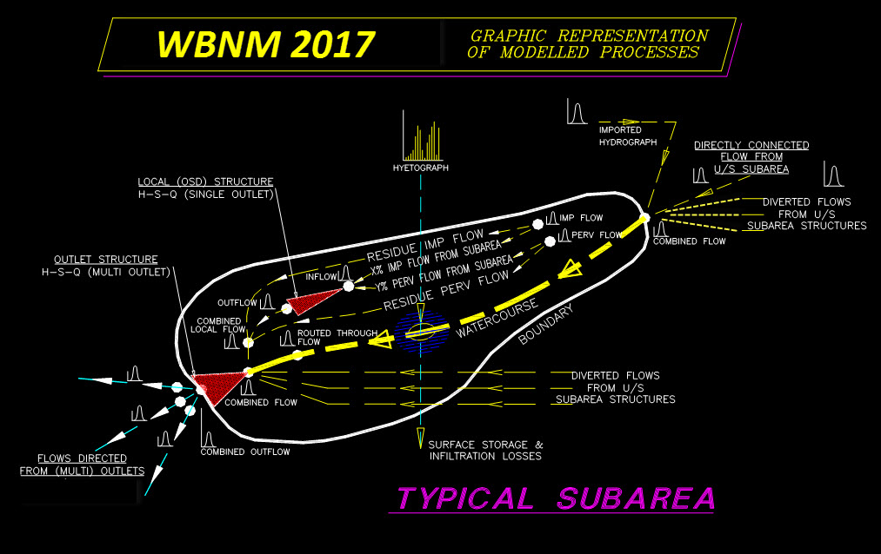
WBNM 2017---------------------------------Overview
MODEL PROCESSES
Base object is the subarea
A model is an ordered collection of subareas
Each subarea has several properties & inputs
WBNM processes each subarea in order
E Rigby Nov 2017

Slide 10
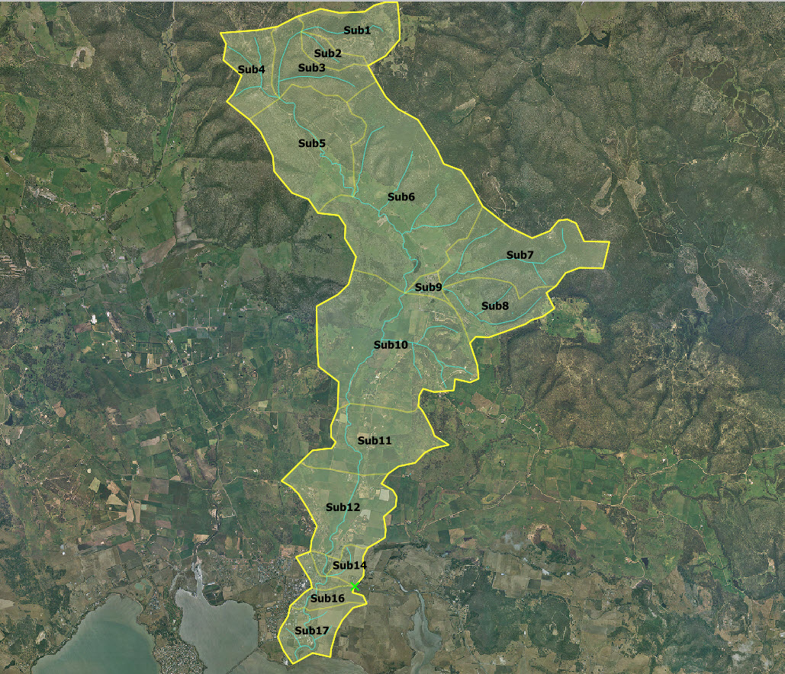
WBNM 2017---------------------------------Overview
MODEL BASIC BUILD TASKS
Subareal Primary Topology Assesment
Subareal ‘Effective’ Impervious Area Assessment
Subareal Stream Routing & Reach Condition Assessment
Subareal Structure(s) Data Acquisition (if present)
Subareal Structure(s) Diversion Characteristics (if present)
=======================================
Rainfall Data Acquisition
Global/Subareal Losses Assessment
Imported Hydrograph(s) Data Acquisition (if present)
Recorded Hydrograph(s) Data Acquisition (if present)
=======================================
Run File Construction
INI File Configuration
Sorell Creek Catchment
E Rigby Nov 2017

Slide 11
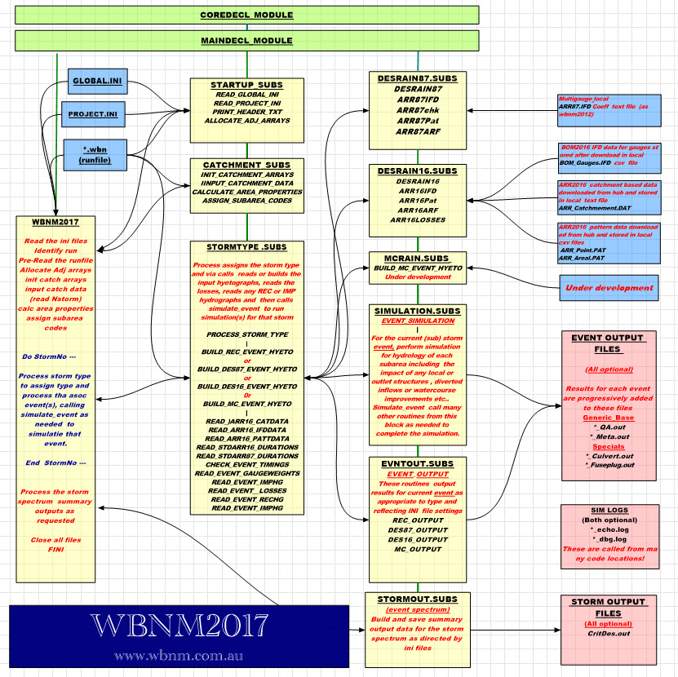
WBNM 2017---------------------------------Overview
WBNM2017 CALL STRUCTURE
Fortran 2003/2008
Modules declaring global variables
Subroutine Blocks
Input Files
Output Files
E Rigby Nov 2017

Slide 12
WBNM 2017---------------------------------Overview
WBNM2017.f90 (sample extract)
! ##### POWER UP WBNM #############################################################
!
! ----- Decode the command line
!
! Get the WBNM executable directory path so know where wbnm executable and GLOBAL.INI home is
!
CALL GET_COMMAND_ARGUMENT(0,lineoftext) ! need .exe command to be full path/filename
wbnm_exe=TRIM(lineoftext)
wbnm_path=path_of(wbnm_exe) ! path_of checks for sep format Win\ Lin/
!
! get the name of the *.wbn run file
!
CALL GET_COMMAND_ARGUMENT(1,lineoftext) ! assumes the wbn runfile is in the cwd
current_model_filename = TRIM(lineoftext)
!
! ----- Now check if exe and runfiles make sense and can be found - exit if not found
!
INQUIRE (FILE=wbnm_exe, EXIST=true_or_false)
IF (.not. true_or_false) THEN ! if wbnm exe not found then abort
PRINT *, "FATAL ERROR!!!! wbnm exe " , TRIM(wbnm_exe), ' not found'
PRINT *, 'Hit any key to terminate run'
READ *, lineoftext
stop
END IF
!
E Rigby Nov 2017

Slide 13
WBNM 2017---------------------------------Overview
WBNM2017 RESULTS
===== WBNM SUMMARY FOR THIS CATCHMENT AND STORM SPECTRUM ========== 7-DES16
DES16 storm dura and pattern spectrum simulation;
1% AEP Storm Duration and Pattern Spectrum -Losses calc -ARF calc
Current model runfile = SorellCk_DES8716.wbn
Catchment Name = Sorell Creek - Sorell - Tasmania
Catchment area (hectares) = 4198.07
Catchment Impervious (%) = 1.95
Storm Burst AEP (%) = 1.00
Crit Burst Dura (mins) = 720 - for max discharge at outlet
Crit Burst Patt = 7 - (nearest >= Qpavg) - Point TP
Rainfall depth pre ARF (mm) = 105.58 - averaged over catchment
ARF = 0.94 - for catchment area & outlet crit burst dura
Rainfall depth post ARF(mm) = 99.35 - averaged over catchment
Perv IL (mm) and CL (mm/hr) = 16.00 & 3.00
Imp IL (mm) and CL (mm/hr) = 1.00 & 0.00
Excess rainfall (mm) = 55.70 - catchment average after all losses
Calc. runoff depth (mm) = 55.73 - from outlet in nearest DES16 pattern >= Qpavg
Calc. peak discharge (m3/s) = 66.38 - from outlet in nearest DES16 pattern >= Qpavg
Calc. peak discharge (m3/s) = 64.59 - from outlet
===== WBNM SUMMARY FOR THIS CATCHMENT AND STORM ==========================
E Rigby Nov 2017

Slide 14
WBNM 2017-----------------------Release Packages
WBNM_ENG (FOS)
Fast single REC storm simulation
Developed as plugin for other packages
WBNM2017 (Freeware)
Comprehensive multi storm DES87/DES16 and REC storm simulations
Developed as a standalone hydrology package incorporating ARR 1987 & ARR 2016 DFE procedures
Base Release November 2017
E Rigby Nov 2017

Slide 15
WBNM 2017-----------------------Release Packages
DOWNLOADING THE PACKAGES
Go to www.wbnm.com.au
(Live demonstration by AJB)
E Rigby Nov 2017

Slide 16
WBNM 2017-----------------------Release Packages
WBNM_ENG CONTENTS
Documentation
Executables
Publications
Sample_Runfiles
Sources
GPL3_Licence
E Rigby Nov 2017

Slide 17
WBNM 2017-----------------------Release Packages
WBNM_ENG DOCUMENTATION
Experienced_User_Notes
WBNM_History
WBNM_Readme
WBNM_References
WBNM_Runfile
WBNM_Theory
WBNM_Tutorial
WBNM_UserGuide
WBNM_Validation
E Rigby Nov 2017

Slide 18
WBNM 2017-----------------------Release Packages
WBNM_ENG EXECUTABLES
global.ini
Version_Control_ENG.txt
Wbnm_eng_w32.exe (still to be uploaded at 17th Nov)
Wbnm_eng_w64.exe
Wbnm_eng_U
E Rigby Nov 2017

Slide 19
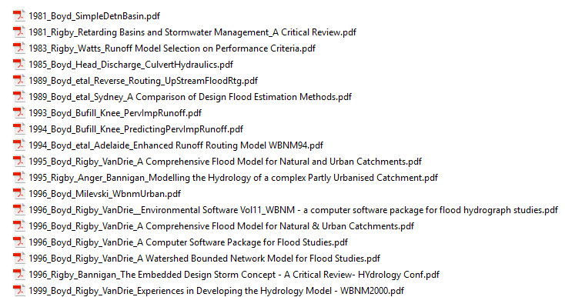
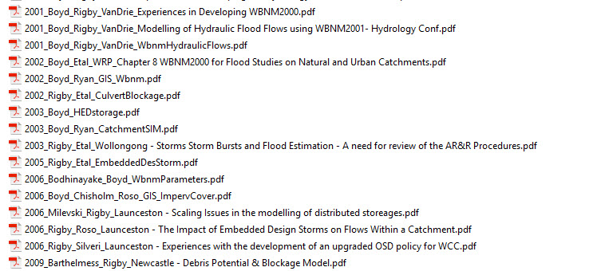
WBNM 2017-----------------------Release Packages
WBNM_ENG PUBLICATIONS
E Rigby Nov 2017

Slide 20
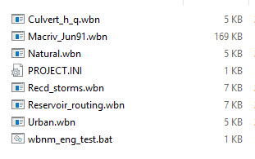
WBNM 2017-----------------------Release Packages
WBNM_ENG SAMPLE_RUNFILES
Any REC storm in the WBNM2017 sample runfiles set can also be run by wbnm_eng.
E Rigby Nov 2017

Slide 21
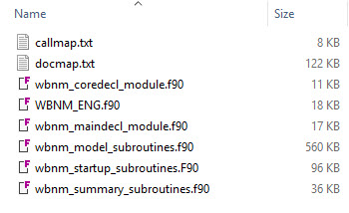
WBNM 2017-----------------------Release Packages
WBNM_ENG SOURCES
Callmap – basic listing of all calls made by each subroutine
Docmap – basic listing of all comment lines in each subroutine
Package sources.f90
WBNM_ENG.f90 (mainline)
Wbnm_coredecl_module.f90 (declarations)
Wbnm_maindecl_module.f90 (declarations)
Wbnm_startup_routines.f90 (dynamic array dims)
Wbnm_model_subroutines.f90 (simulation)
Wbnm_summary_subroutines.f90 (declarations)
E Rigby Nov 2017

Slide 22
WBNM 2017-----------------------Release Packages
WBNM_ENG GPL3 LICENCE
Rather long so not reproduced in this presentation.
Basically allows any use/modification of the code provided;
The original code source is acknowledged
Any modified version of the code is also released as FOS
Any use of the code or parts of the code in other software is restricted to software that is also released as FOS.
E Rigby Nov 2017

Slide 23
WBNM 2017-----------------------Release Packages
WBNM2017 CONTENTS
Documentation
Executables
Publications
Sample_Runfiles
E Rigby Nov 2017

Slide 24
WBNM 2017-----------------------Release Packages
WBNM_ENG DOCUMENTATION
Experienced_User_Notes
WBNM_History
WBNM_Readme
WBNM_References
WBNM_Runfile
WBNM_Theory
WBNM_UserGuide
WBNM_Validation
WBNM_Structure
E Rigby Nov 2017

Slide 25
WBNM 2017-----------------------Release Packages
WBNM2017 EXECUTABLES
global.ini
Version_Control.txt
Wbnm2017_W32.exe
Wbnm2017_W64.exe
Wbnm2017_U
E Rigby Nov 2017

Slide 26
WBNM 2017-----------------------Release Packages
WBNM2017 PUBLICATIONS
E Rigby Nov 2017

Slide 27
WBNM 2017-----------------------Release Packages
WBNM2017 SAMPLE_RUNFILES
REC Storms (short tests)
Natural_RecdHG.wbn - sample runfile for a natural catchment with recorded storm
Urban.wbn - runfile for part urban catchment with recorded storm
Reservoir_routing.wbn - file which lets you use WBNM for flood routing of an inflow
hydrograph through a storage reservoir
Onsite_detention.wbn - small onsite detention storage calculations
Culvert_h_q.wbn - file which lets you use WBNM to calculate culvert hydraulics
REC Storms (full models)
MacRiv_Jun9116.wbn - file representing a very complex catchment with storages/Xflows
PRSC_FWS_Model_24_10_07.wbn- file representing a very large and complex catchment
E Rigby Nov 2017

Slide 28
WBNM 2017-----------------------Release Packages
WBNM2017 SAMPLE_RUNFILES (ctd)
DES87 Storms (short tests)
Design_external.wbn - An ARR 1987embedded design storm, with design rainfall IFD coefficients
located in an external IFD file rather than in the runfile
Storage_partfull.wbn - storage reservoir part full at start of storm
Storage_hsq.wbn - a repeat of STORAGE_INLETCONTROL.WBN, but using an entered
table of elevation-storage-discharge values, rather than specifying culvert dimensions
Storage_blockage.wbn - a storage with one of the outlets blocked by debris
Storage_dead.wbn - storage reservoir that must fill to specified elevation before outflowing
Storage_flow_divsns.wbn - structure that diverts flows to multiple downstream points (m3/s)
Storage_inletcontrol.wbn - runfile for storage reservoir with culvert inlet control
Storage_outlet_chnl.wbn - storage reservoir with culvert outlet control, tailwater set by trapezoidal downstream channel
Storage_outlet_fixed.wbn - storage reservoir with culvert outlet control, fixed tailwater level
Storage_outlet_rating.wbn - storage reservoir with culvert outlet control, tailwater set by rating curve in downstream channel
Storage_scourable.wbn - storage reservoir with erodible spillway
Storage_divert.wbn - storage that diverts flows that exceed a nominated discharge (m3/s)
WSUD_micro.wbn - example of Water Sensitive Urban Design at the micro scale
Offstream_storage.wbn - a storage located offstream, but directly connected to the stream channel
HED_Onsite_detention.wbn - onsite detention using a High Early Discharge outlet
Road_Embankment.wbn - models flow over a road embankment with a dip
E Rigby Nov 2017

Slide 29
WBNM 2017-----------------------Release Packages
WBNM2017 SAMPLE_RUNFILES (ctd)
DES87 Storms (full models)
Design_Spectrum87.wbn - example of a DES87 storm spectrum runfile
EMB87 storms (short tests)
Embedded_design.wbn - demonstrating a design burst embedded within a longer design storm even
EMBdesign_external.wbn - the same embedded design storm, but with design rainfall IFD coefficients
located in an external IFD file rather than in the runfile
EMB87 storms (full models)
Horsley_Design_2005_All_Clear.wbn - example of an embeded design ARR 1987 storm on a real catchment
DES16 storms (short tests)
DES16_Sample_Catch.wbn - Example of an ARR 2016 design storm on a simple catchment
DES16/DES87 storms (full models)
AllansCk_Test.wbn - Full real catchment model with ARR87 and ARR16 design storms
SorellCk_Test.wbn - Full real catchment model with ARR87 and ARR16 design storms
Macriv_Test.wbn - Full real catchment model with ARR87 and ARR16 design storms
E Rigby Nov 2017

Slide 30
WBNM 2017-----------------------Support Packages
iWBNM - Andrew Wiersma andrew.wiersma@gmail.com
What’s New?
Compatible with the new WBNM 2017 Engine
Reads in results in either 2012 or 2017 formats
Use of array-writing to speed up importing of .wbn and .out files
Format changes to remove most limitations:
Unlimited subareas
Unlimited design / recorded storms
Unlimited gauges
New structure viewer (structure details can be input into specific database-style tables, or the viewer used to edit and save)
E Rigby Nov 2017

Slide 31
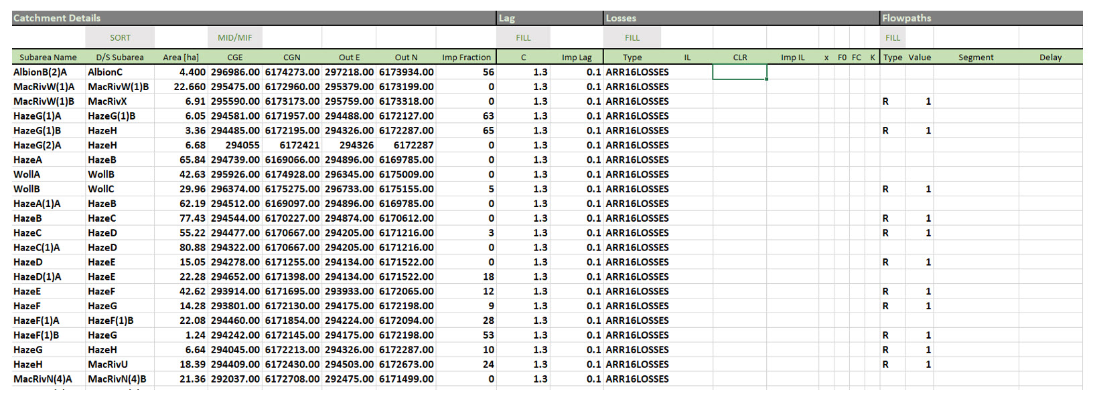
WBNM 2017-----------------------Support Packages
iWBNM
E Rigby Nov 2017

Slide 32
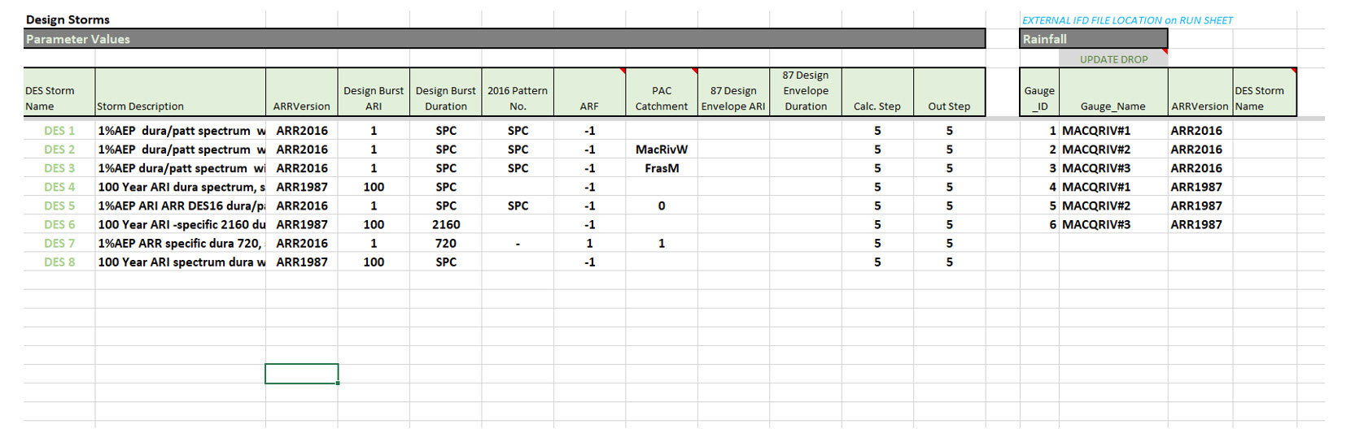
WBNM 2017-----------------------Support Packages
iWBNM
E Rigby Nov 2017

Slide 33
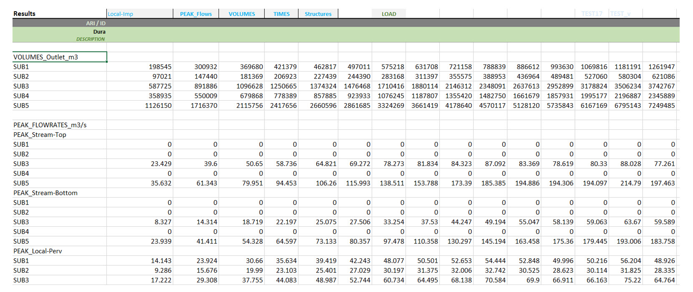
WBNM 2017-----------------------Support Packages
iWBNM
E Rigby Nov 2017

Slide 34
WBNM 2017-----------------------Support Packages
Storm Injector - Chris Ryan cryan@csse.com.au
E Rigby Nov 2017

Slide 35

WBNM 2017------------------------------------------------------
E Rigby Nov 2017

Slide 36
WBNM 2017---------------------------------Basic Usage
#####START_PROJECT_INITIALISATION############################
usr_name=Ted Rigby
org_name=Rienco Consulting
org_function=Engineering Hydrologists
org_street=5 Pelham St
org_city=Sorell
org_state=Tasmania
org_zip=7172
org_country=Australia
org_phone=0437 250 500
org_fax=NA
org_email=ted.rigby@rienco.com.au
out_QAsum=.TRUE.
out_metafile=.FALSE.
out_culverts=.FALSE.
out_scourable=.FALSE.
out_critdes=.TRUE.
dbg_run =.FALSE.
dbg_echo =.FALSE.
sum_subareas=.FALSE.
sum_depths=.FALSE.
sum_catchment=.TRUE.
sum_volumes=.FALSE.
sum_outlet_structures=.FALSE.
sum_local_structures=.FALSE.
sum_Qpeaks=.FALSE.
sum_Tpeaks=.FALSE.
sum_Storms=.TRUE.
trig_flowmin=5
Snyder_multiplier=3
#####END_PROJECT_INITIALISATION##############################
RUNFILE INPUT INI FILES
(all optional )
GLOBAL.INI (in wbnm2017.exe dir ) (Your office standard)
PROJECT.INI (in runfile dir) (Your project specific configuration)
Both INIs cover the same parameters but individual projects may require different parameters. GLOBAL.INI read first, PROJECT.INI updates so only need to include changed parameters in PROJECT.INI.
Practically, if keep PROJECT.INI’s output settings fully populated does make changes easier to manage!
E Rigby Nov 2017

Slide 37
WBNM 2017---------------------------------Basic Usage
RUNFILE INPUT INI FILES (all optional )
out_QAsum=.TRUE. IF .TRUE. (Creates QA file & output – storm summary results only)
out_metafile=.FALSE. (Creates Meta file& output – detail hydrographs for each event)
out_culverts=.FALSE. (Creates detailed culvert result file & culvert output for each event)
out_scourable=.FALSE. (Creates detailed scourable weir result file & output for each event)
out_critdes=.TRUE. (Creates detailed design storm summary result file & output for each storm)
dbg_run =.FALSE. (Creates detail debug log file with considerable intermediate output – can be huge!)
dbg_echo =.FALSE. (Creates an echo of the input runfile as data is read in – can help debug)
sum_subareas=.FALSE. (Adds a subareal summary for each event to the meta file)
sum_depths=.FALSE. (Adds a depths summary for each event to the meta file)
sum_catchment=.TRUE. (Adds a catchment summary for each event to the meta file)
sum_volumes=.FALSE. (Adds a volumes summary for each event to the meta file)
sum_outlet_structures=.FALSE. (Adds an outlet structures summary for each event to the meta file)
sum_local_structures=.FALSE. (Adds a local structures summary for each event to the meta file)
sum_Qpeaks=.FALSE. (Adds a peak flow summary for each event to the meta file)
sum_Tpeaks=.FALSE. (Adds a time to peak summary for each event to the meta file)
sum_Storms=.TRUE. (Adds to the QA file and displays on screen a storm summary for each storm)
trig_flowmin=5 (Flow as percentage of peak at which hydrographs are truncated in meta file)
Snyder_multiplier=3 ( A factored Snyder lag added to the hyetograph duration to set hydrograph dura)
E Rigby Nov 2017

Slide 38
WBNM 2017---------------------------------Basic Usage
RUNFILE INPUT DATA FILES
REC Storm (no external requirements)
DES87/EMB87 Storm (runfile or external IFD data)
DES16 Storm (external IFD data - BOM)
(external temporal patterns - Hub)
(runfile or external ARF data)
(runfile or external losses data)
Cannot run a DES16 simulation without external BOM/Hub data!
E Rigby Nov 2017

Slide 39
WBNM 2017---------------------------------Basic Usage
RUNFILE OUTPUT FILES (all optional)
Runfile_QA.out (Highly summarised record of run with warnings)
Runfile_meta.out (Detail event outputs as requested in INI – HUGE!)
Runfile_CritDes.out (Storm summary for DFE ARR1987 and ARR2016)
Runfile_culv.out (Detail output of culvert hydraulics)
Runfile_scour.out (Detail output of scourable weir hydraulics)
Runfile_echo.log (Copy of input runfile as read in internally)
Runfile_dbg.log (Intermediate output of calcs for diags – LARGE!)
E Rigby Nov 2017

Slide 40
WBNM 2017---------------------------------Basic Usage
RUNFILE FORMAT (BLOCKS)
Model Preamble
Model Status
Model Display
Subareal Topology
Subareal Surfaces
Subareal Stream Routing
Subareal Local Structures
Subareal Outlet Structures
(Catchment Physiography)
Storm Details
Weighting Details
Losses Details
Imported Hydrographs
Recorded Hydrographs
(Applied Storms)
E Rigby Nov 2017

Slide 41
WBNM 2017---------------------------------Basic Usage
RUNFILE FORMAT (Model Preamble Block)
8 Lines fixed – Content user based, could be all blanks – Read only!
#####START_PREAMBLE_BLOCK##########|###########|###########|###########|
RUNFILE Sorell Rivulet.wbn
Part of ARR 2016 test suite to compare DFE between ARR 1987 and ARR 2016
MOSTLY NATURAL CATCHMENT, 1% AEP DESIGN STORM
3 design rain gauges, rainfall in mm/hour
Catchment Area 42km2
Catchment Shape Factor 5.2 (L/Wavg Significantly elongated)
Lightly forested headwaters - pasture centrally - urban bottom section
Low avg annual rainfall area and low rainfall gradients
#####END_PREAMBLE_BLOCK############|###########|###########|###########|
Each block followed by two blank lines!
E Rigby Nov 2017

Slide 42
WBNM 2017---------------------------------Basic Usage
RUNFILE FORMAT (Model Status Block)
4 Lines fixed – Content mostly user based – wbnm checks version is compatible!
#####START_STATUS_BLOCK############|###########|###########|###########|
Z:\Projects\2016\16008-01 Sorell Rivulet\SorellRivulet.wbn
last edited 16/1/2017
by Ted Rigby
2017_000 Current-operational-version #####END_STATUS_BLOCK##############|###########|###########|###########|
E Rigby Nov 2017

Slide 43
WBNM 2017---------------------------------Basic Usage
RUNFILE FORMAT (Model Display Block)
3 Lines fixed – Under review – Likely change – will be backward compatible!
#####START_DISPLAY_BLOCK###########|###########|###########|###########|
542398.00 5276447.00 553393.00 5261203.00
Sorell_Ck_Subareal_Layout.shp <or ‘none’>
542398.00 5276447.00 553393.00 5261203.00 553393.00 5276447.00
#####END_DISPLAY_BLOCK#############|###########|###########|###########|
E Rigby Nov 2017

Slide 44
WBNM 2017---------------------------------Basic Usage
RUNFILE FORMAT (Model Topology Block)
One line for each sub CG (E,N) – Outlet (E,N) – Flows to sub (last flows to SINK)
#####START_TOPOLOGY_BLOCK##########|###########|###########|###########|
5 Sorell Creek (partial) - Sorell - Tasmania
Sub01 547321.69 5275470.50 546096.69 5275432.50 Sub03
Sub02 546675.63 5274965.50 546096.69 5275432.50 Sub03
Sub03 546326.50 5274650.50 545613.69 5273980.00 Sub05
Sub04 545008.69 5274613.00 545613.69 5273980.00 Sub05
Sub05 546329.31 5272997.00 547226.88 5271831.50 SINK
#####END_TOPOLOGY_BLOCK############|###########|###########|###########|
Coordinates can all be zero if not using inverse distance rainfall weighting and not interested in spatial display.
Outlet coordinates not used at all by wbnm (spatial display purposes only).
E Rigby Nov 2017

Slide 45
WBNM 2017---------------------------------Basic Usage
RUNFILE FORMAT (Model Surfaces Block)
#####START_SURFACES_BLOCK##########|###########|###########|###########|
0.77 1.5 0.10 <Current m, C, implagfactor
-99.90 < Q when routing becomes linear
Sub01 185.94 0.00 <1.50 0.10 legacy>
Sub02 57.69 0.00 1.50 0.10
Sub03 188.88 0.00 <area, %imp
Sub04 169.12 0.00 1.50 0.10
Sub05 431.25 0.00 1.50 0.10
#####END_SURFACES_BLOCK############|###########|###########|###########|
NOTES 1. Use of C, ImpLagFactor per subarea still supported, but not recommended!
2. Percent Impervious cover is the effective impervious cover, EIA/TIA = 0.5 to 0.75??
E Rigby Nov 2017

Slide 46
WBNM 2017---------------------------------Basic Usage
RUNFILE FORMAT (Model Flowpaths Block)
#####START_FLOWPATHS_BLOCK#########|###########|###########|###########|
2 < 2 subareas with routable streams
Sub03 < subarea that includes a stream
#####ROUTING < routing method
1.00 < Stream lag factor (1.0 is natural)
Sub05
#####ROUTING
1.00
#####END_FLOWPATHS_BLOCK###########|###########|###########|###########|
Note wbnm runs correctly if all subs are included – not just those with streams – but untidy!
E Rigby Nov 2017

Slide 47
WBNM 2017---------------------------------Basic Usage
RUNFILE FORMAT (MODEL Local_Structures Block)
#####START_LOCAL_STRUCTURES_BLOCK##|###########|###########|###########|
0
#####END_LOCAL_STRUCTURES_BLOCK####|###########|###########|###########|
These are smaller offstream basins on the subarea only receiving flow from part of the subarea (typical OSD), discharging via multiple potential outlets to the bottom of the subarea. These are discussed further in the following ‘ADVANCED USEAGE’ section of this presentation.
E Rigby Nov 2017

Slide 48
WBNM 2017---------------------------------Basic Usage
RUNFILE FORMAT (MODEL Outlet_Structures Block)
#####START_OUTLET_STRUCTURES_BLOCK#|###########|###########|###########|
0
#####END_OUTLET_STRUCTURES_BLOCK###|###########|###########|###########|
These are larger onstream basins at the subarea outlet receiving flow from the stream, any upstream diversions and the local subarea, discharging via multiple potential outlets to the top of the next downstream catchment and other nominated locations in the topologically downstream catchment. These are discussed further in the following ‘ADVANCED USEAGE’ section of this presentation.
E Rigby Nov 2017

Slide 49
WBNM 2017---------------------------------Basic Usage
RUNFILE FORMAT (MODEL Storm Block)
#####START_STORM_BLOCK#############|###########|###########|###########|
6 <number of storms in storm block
#####START_STORM#1
1%AEP Storm, Duration and Pattern spectrum, Losses & ARF calc to ARR2016
5.00 <min calculation timestep
10.00 <min output timestep
E Rigby Nov 2017

Slide 50
WBNM 2017---------------------------------Basic Usage
RUNFILE FORMAT (MODEL Storm Block)
5 options for storm type are;
#####START_RECORDED_RAIN (Storm event based on input hyetographs – typically historic)
#####START_DESIGN_RAIN_ARR1987 (Design ARR 1987 storm event or dura spectrum)
#####START_EMBEDED_DESIGN_RAIN_ARR1987 (Design ARR 1987 embedded design event)
#####START_DESIGN_RAIN_ARR2016 (Design ARR 2016 storm event or dura/pattern spectrum)
#####START_MC_ANALYSIS (not yet implemented)
E Rigby Nov 2017

Slide 51
WBNM 2017---------------------------------Basic Usage
RUNFILE FORMAT (MODEL Storm Block) - REC STORM (event)
#####START_STORM#1
Historic Storm, June 2011, Losses previously calibrated
5.00 <min calculation timestep
15.00 <min printout timestep
#####START_RECORDED_RAIN
June 1991 Event < event description
12am on 7/6/91 to 9am on 12/6/91 < start-stop times
1548 5.00 < no of values and timestep
MM/HOUR < units of values
5 < no of gauges
ALBIONPK_SW < beginning of gauge1 block of rec rainfall
295320.00 6172349.00 < cords of Gauge1
6.00 < rainfall at t=1 of 1548 for gauge1
6.00
6.00
……… < etc
0.00
0.00
0.00
0.00
0.00 < green block repeats for each gauge
#####END_RECORDED_RAIN
E Rigby Nov 2017

Slide 52
WBNM 2017---------------------------------Basic Usage
RUNFILE FORMAT (MODEL Storm Block) – DES87 STORM
#####START_STORM#8
100 Year ARI spectrum dura with GLOBAL fixed 50-2.5-0.0 losses -ARR87 ARF
5.00 < calc timestep
5.00 < print timestep
#####START_DESIGN_RAIN_ARR1987
100 -1 -1 < ARI, duration, ARF
IFD_COEFFS_IN_IFD_FILE < location of IFD data
MacRivdesignMGA.ifd < name of relevant IFD file
3 < no of design gauges
MACQRIV#1
MACQRIV#2
MACQRIV#3
#####END_DESIGN_RAIN_ARR1987
E Rigby Nov 2017

Slide 53
WBNM 2017---------------------------------Basic Usage
RUNFILE FORMAT (MODEL Storm Block) – EMB87 STORM
#####START_STORM#1
EMBEDDED DESIGN STORM, WITH IFD COEFFICIENTS LOCATED IN THIS RUNFILE.
5.00 < calc timestep
5.00 < print timestep
#####START_EMBEDDED_DESIGN_RAIN_ARR1987
100 120 100 540 1.00 < Burst ARI,Burst Dura,Env ARI,Env Dura, ARF
IFD_COEFFS_IN_THIS_FILE
2
GAUGE1 1 W7892-1 15000.00 9000.00 1250.00 22.00 etc..
GAUGE2 1 W7892-1 7000.00 5000.00 1170.00 24.00 etc..
#####END_EMBEDDED_DESIGN_RAIN_ARR1987
Note – Only specific durations allowed in EMB87 design event (no spectrums)
E Rigby Nov 2017

Slide 54
WBNM 2017---------------------------------Basic Usage
RUNFILE FORMAT (MODEL Storm Block) DES16 STORM event & spectrum
#####START_STORM#6
1%AEP Storm, Duration and Pattern spectrum, Losses & ARF calc to ARR2016
5.00 < min calculation timestep
5.00 < min printout timestep
#####START_DESIGN_RAIN_ARR2016
1.0 -1 -1 -1 < AEP, duraspec, pattspec, ARF calc
IFD_DATA_IN_DATABASE_FILE < header identifying where IFD data is
Tasmanian_Rainfall_IFDdatabase.csv < IFD multigauge database pathname
3 < number of design gauges in model
SorellCkBot < gauge names in above IFD database
SorellCkMid
SorellCkTop
PAT_DATA_IN_REGION_FILE < header identifying where pattern data is
Southern_Slopes_Tasmania_Increments.csv < pathname of pattern file (point)
CAT_DATA_IN_CATCHMENT_FILE < header identifying where loss/misc data is
SorellCk_Catchment.txt < pathname of physical catchment data file
#####END_DESIGN_RAIN_ARR2016
E Rigby Nov 2017

Slide 55
WBNM 2017---------------------------------Basic Usage
RUNFILE FORMAT (MODEL Weighting Block)
#####START_CALC_RAINGAUGE_WEIGHTS < header means use calc inv dist procedure
#####END_CALC_RAINGAUGE_WEIGHTS
Or:::
#####START_INPUT_RAINGAUGE_WEIGHTS < header means use supplied weights
<Do for each subarea>
SUBAREA_NAME THIESSEN_WEIGHTS_FOR_EACH_GAUGE……..
<End Do for each subarea>
#####END_INPUT_RAINGAUGE_WEIGHTS
E Rigby Nov 2017

Slide 56
WBNM 2017---------------------------------Basic Usage
RUNFILE FORMAT (MODEL Losses Block)
#####START_LOSS_RATES < header means use IL/CL losses
ARR16LOSSES < means use ARR 2016 loss procedure
#####END_LOSS_RATES
Note ARR16losses has limitations where no hub data or preburst > Storm IL
Or:::
#####START_LOSS_RATES < header means use IL/CL losses
GLOBAL 35.00 2.50 1.0 < Ilperv Clperv ILImp GLOBAL losses for all subareas
#####END_LOSS_RATES
Or:::
#####START_LOSS_RATES < header means use IL/CL losses
<Do for each subarea>
Subarea_name Ilperv Clperv ILImp < specified losses for each subarea
<End do for each subarea>
#####END_LOSS_RATES
E Rigby Nov 2017

Slide 57
WBNM 2017---------------------------------Basic Usage
RUNFILE FORMAT (MODEL Recorded Hydrographs Block)
#####START_RECORDED_HYDROGRAPHS
0 < none – otherwise location, no ords, timestep, units & time series
#####END_RECORDED_HYDROGRAPHS
E Rigby Nov 2017

Slide 58
WBNM 2017---------------------------------Basic Usage
RUNFILE FORMAT (MODEL Imported Hydrographs Block)
#####START_IMPORTED_HYDROGRAPHS
0 < none – otherwise location, no ords, timestep, units & time series
#####END_IMPORTED_HYDROGRAPHS
#####END_STORM#6
E Rigby Nov 2017

Slide 59
WBNM 2017---------------------------------Basic Usage
RUNNING WBNM2017 on WINDOWS :
Make sure you have the new global.ini in the WBNM2017 exe directory (appropriately configured for your purposes).
Make sure you have the new project.ini in the directory of your runfiles (appropriately configured).
Note:
All Fatal Errors display on screen.
All warnings are recorded in the QA file (so important to enable it in INI settings)
Minor changes to the metafile and spectrum runs can create massive metas.
Considerable additional output to the debug log – can also be a very large file!
E Rigby Nov 2017

Slide 60
WBNM 2017---------------------------------Basic Usage
RUNNING WBNM2017 on WINDOWS :
Running from the command line - in a command window type :
cd fullpath_to_my_runfiles <CR>
(eg cd c:\WBNM2017\SampleRunfiles <CR> )then type
full path to_WBNM2017_var.exe <space> mymodel.wbn <CR>
(eg c:\WBNM2017\WBNM2017_w64.exe Natural16.wbn <CR> )
Note WBNM2017 exits automatically on completion so don’t retain screen storm summary.
A copy of the storm summary can be viewed in the QA summary or Meta file if enabled.
E Rigby Nov 2017

Slide 61
WBNM 2017---------------------------------Basic Usage
RUNNING WBNM2017 on WINDOWS :
Running from a batch file - (Note - relative addressing does not seem to work!)
For maximum reliability suggest formatting the batch file as follows;
REM move to the runfile drive
Z:
REM cd to the runfiles directory on that drive
cd Z:\projects\WBNM2017\SampleRunfiles
REM run WBNM2017 with the runfile noting that
REM runfile and PROJECT.INI are now in the current directory
Z:\projects\WBNM2017\WBNM2017_w64.exe Natural16.wbn
The above command line can be repeated as many times as necessary.
Generally helpful to add pause at end of the block so screen results are not cleared
Pause
E Rigby Nov 2017

Slide 62
WBNM 2017---------------------------------Basic Usage
RUNNING WBNM2017 on WINDOWS :
Running Using Association
In windows the wbn runfile can be ‘associated’ with a program of your choice so that clicking the runfile executes that runfile with the associated program. If say WBNM2017_w64.exe is associated with files with a wbn extension, clicking on a runfile with that extension will run it with the associated engine. This is probably the most direct approach for those windows users that are normally running only a single wbn runfile at a time but it does not retain the screen summary on termination – this is however reproduced in the QA summary file and Meta file.
E Rigby Nov 2017

Slide 63
WBNM 2017---------------------------------Basic Usage
RUNNING WBNM2017 on Linux/Ubuntu :
!!!! NOTE LINUX IS CASE SENSITIVE !!!!!
Running from the command line - in a terminal window type :
cd fullpath_to_my_runfiles
(eg cd /home/ted/projects/WBNM2017/SampleRunfiles) then type
full path to_WBNM2017 <space> mymodel.wbn
(eg /home/ted/projects/WBNM2017/WBNM2017_U Natural16.wbn )
E Rigby Nov 2017

Slide 64
WBNM 2017---------------------------------Basic Usage
RUNNING WBNM2017 on Linux/Ubuntu :
Running from a script file - (Note - relative addressing does not work!)
For maximum reliability suggest formatting the bash script as follows;
# cd to the runfiles directory
cd /home/ted/projects/WBNM2017/SampleRunfiles
# run the engine with the runfile
# runfile and PROJECT.INI are now in the current directory
/home/ted/projects/WBNM2017\/WBNM2017_U Natural16.wbn
The above command line can be repeated as many times as necessary.
E Rigby Nov 2017

Slide 65
WBNM 2017---------------------------------Basic Usage
DES16 STORM (Results)(screen, QA and Metafile)
===== WBNM SUMMARY FOR THIS CATCHMENT AND STORM SPECTRUM ========== 10-DES16
DES16 storm dura and pattern spectrum simulation;
1% AEP Dura and Pattern Spectrum - Losses calc - ARF calc
Current model runfile = SorellCk_Test.wbn
Catchment Name = Sorell Creek - Sorell - Tasmania
Catchment area (hectares) = 4198.07
Catchment Impervious (%) = 1.95
Storm Burst AEP (%) = 1.00
Crit Burst Dura (mins) = 360 - for max discharge at outlet
Crit Burst Patt = 6 - (nearest >= Qpavg) - Point TP
Rainfall depth pre ARF (mm) = 71.77 - averaged over catchment
ARF = 0.91 - for catchment area & outlet crit burst dura
Rainfall depth post ARF(mm) = 65.26 - averaged over catchment
Perv IL (mm) and CL (mm/hr) = 5.60 & 3.00
Imp IL (mm) and CL (mm/hr) = 1.00 & 0.00
Excess rainfall (mm) = 43.52 - catchment average after all losses
Calc. runoff depth (mm) = 43.65 - from outlet in nearest DES16 pattern >= Qpavg
Calc. peak discharge (m3/s) = 71.99 - from outlet in nearest DES16 pattern >= Qpavg
Calc. peak discharge (m3/s) = 71.30 - from outlet
===== WBNM SUMMARY FOR THIS CATCHMENT AND STORM ==========================
E Rigby Nov 2017

Slide 66
WBNM 2017---------------------------------Basic Usage
DES16 STORM (Results) (_CritDes.out file)
##### WBNM - START DURATION SPECTRUM SUMMARY FOR 1.00 % AEP STORM ############### 10-DES16
##### DES16 storm dura and pattern spectrum simulation;
##### 1% AEP Dura and Pattern Spectrum - Losses calc - ARF calc
##### Note -the outlet max discharge is the ARR 2016 DFE for the catchmentC
##### Partial area checks may be needed to establishm ARR 2016 DFEs
##### at other locations internal to the catchment!
SUBAREA 10 15 30 60 120 180 360 720 1440 2880 4320 5760 7200 8640 10080
Sub01 0.000 0.000 0.000 0.415 3.411 5.663 6.098 4.935 4.093 4.707 3.338 2.644 2.538 2.767 3.953
Sub02 0.000 0.000 0.000 0.211 1.458 2.200 2.305 1.720 1.368 1.555 1.080 0.866 0.833 0.904 1.285
Sub03 0.000 0.000 0.000 0.479 5.458 11.050 12.434 10.607 8.998 10.462 7.539 5.924 5.702 6.243 8.901
Sub04 0.000 0.000 0.000 0.390 3.185 5.240 5.631 4.526 3.742 4.299 3.043 2.412 2.315 2.525 3.606
Sub05 0.000 0.000 0.000 0.728 8.734 20.132 25.576 22.454 19.544 22.131 16.507 12.699 12.157 13.302 18.930
Sub06 0.000 0.000 0.000 0.854 10.574 25.762 40.000 36.406 31.895 33.722 26.639 19.842 18.940 19.815 28.329
Sub07 0.000 0.000 0.000 0.529 5.435 9.748 10.701 8.915 7.402 8.369 5.872 4.515 4.329 4.736 6.850
Sub08 0.771 0.766 0.715 0.704 3.728 6.152 6.584 5.239 4.256 4.827 3.361 2.603 2.494 2.723 3.930
Sub09 0.393 0.424 0.490 0.771 8.585 15.826 17.583 14.529 12.046 13.688 9.636 7.407 7.105 7.773 11.225
Sub10 2.469 2.498 2.384 2.226 17.052 41.023 65.288 60.166 52.416 54.415 43.698 31.823 30.579 31.395 45.425
Sub11 1.164 1.198 1.242 1.377 17.256 41.679 68.119 63.738 55.255 57.031 46.080 33.142 32.000 32.475 47.527
Sub12 2.514 2.556 2.474 2.178 17.248 41.833 70.330 67.032 57.677 59.318 47.960 34.102 32.988 33.323 49.091
Sub13 0.906 1.238 1.617 1.617 17.235 41.803 70.395 67.147 57.794 59.407 48.030 34.132 33.013 33.359 49.134
Sub14 0.426 0.421 0.389 0.331 1.068 1.628 1.629 1.110 0.809 0.887 0.578 0.440 0.422 0.460 0.690
Sub15 1.294 1.376 1.688 1.773 17.249 41.868 70.930 67.951 58.421 59.992 48.479 34.373 33.251 33.604 49.520
Sub16 1.459 1.516 1.642 1.690 17.204 41.777 71.054 68.331 58.759 60.260 48.701 34.470 33.335 33.706 49.670
Sub17 3.068 3.154 3.116 2.783 17.093 41.565 71.305 69.236 59.573 60.880 49.203 34.682 33.515 33.891 50.008
##### WBNM - END DURATION SPECTRUM SUMMARY FOR 1.00 % AEP STORM ###########################
E Rigby Nov 2017

Slide 67
WBNM 2017---------------------------------Basic Usage
DES16 STORM (Results) (_CritDes.out file)
ANALYSIS OF A 1.00% DESIGN ARR 2016 STORM SPECTRUM ON Sorell Creek - Sorell - Tasmania
##### WBNM - START DES16 SPECTRUM SUMMARY OF CRITICAL DURATIONS/PATTERNS FOR STORM # 10-DES16 ########
##### DES16 storm dura and pattern spectrum simulation;
##### 1% AEP Dura and Pattern Spectrum - Losses calc - ARF calc
##### Note -the outlet Opeakavg is the actual ARR 2016 DFE for the catchment.
##### Partial area checks may be needed to establish actual ARR 2016 DFEs
##### at other locations internal to the catchment!
SUBAREA CRITICAL CRITDURA CRITPATT QpeakAvg peakPatt TpeakPatt VolPatt
OUTLET EVENTUID (min) (m3/sec) (m3/sec) (min) (m3e3)
Sub01 10-12-4(DES16) 360 4 6.10 6.81 345. 86.
Sub02 10-12-4(DES16) 360 4 2.31 2.42 345. 27.
Sub03 10-12-4(DES16) 360 4 12.43 13.90 360. 199.
Sub04 10-12-4(DES16) 360 4 5.63 6.27 345. 78.
Sub05 10-12-4(DES16) 360 4 25.58 28.88 360. 471.
Sub06 10-12-1(DES16) 360 1 40.00 40.54 360. 849.
Sub07 10-12-4(DES16) 360 4 10.70 12.31 345. 171.
Sub08 10-12-4(DES16) 360 4 6.58 7.36 345. 93.
Sub09 10-12-4(DES16) 360 4 17.58 19.93 355. 278.
Sub10 10-12-6(DES16) 360 6 65.29 65.48 345. 1459.
Sub11 10-12-6(DES16) 360 6 68.12 68.91 360. 1591.
Sub12 10-12-6(DES16) 360 6 70.33 70.98 375. 1719.
Sub13 10-12-6(DES16) 360 6 70.40 71.06 380. 1727.
Sub14 10-12-4(DES16) 360 4 1.63 1.78 180. 10.
Sub15 10-12-6(DES16) 360 6 70.93 71.60 380. 1758.
Sub16 10-12-6(DES16) 360 6 71.05 71.74 390. 1780.
Sub17 10-12-6(DES16) 360 6 71.30 71.99 405. 1833.
##### WBNM - END DESIGN SPECTRUM SUMMARY OF CRITICAL RESULTS FOR STORM #############################
E Rigby Nov 2017

Slide 68
WBNM 2017---------------------------------Basic Usage
WBNM2017 LIMITATIONS
DES87 – Has no PAC - superseded by ARR 2016
DES16 – No sub-daily IFD for events rarer than 1%
Hub loss data not always present
Hub aerial patterns only for duras >= 720min
PMP on hold pending sub-daily IFD being released
No MC procedure (proposed future functionality)
Annoying fortran inability to respond to CR as run terminator
NOTE: BOM/Hub Limitations!
E Rigby Nov 2017

Slide 69
WBNM 2017-----------------------------------------------------
E Rigby Nov 2017

Slide 70
WBNM 2017--------------------------Advanced Usage
Spatial Rainfall & Rain gauge Locations
Simulating Moving Storms
Editing your ARR2016 rainfall.csv file
Spatial Losses
Stream Improvements
Complex Structures/ Blockages
Internal Diversions
External Diversions
Abnormal Floodplain Storage
Partial Area Checks
Using to Sanity Check a Hydraulic Model
Use as a Surrogate Hydraulic Model
Feeding a Hydraulic Model
E Rigby Nov 2017

Slide 71
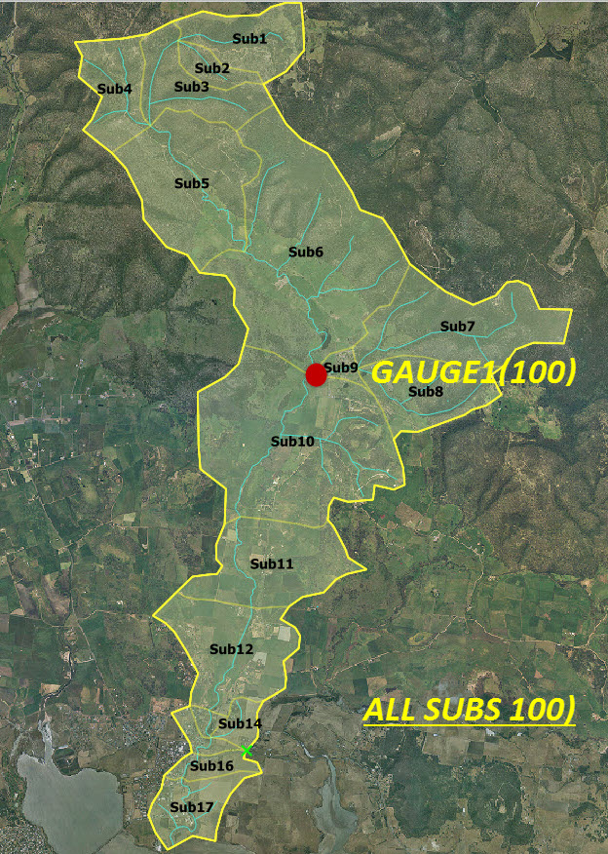
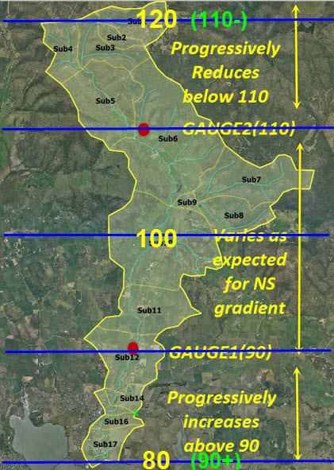
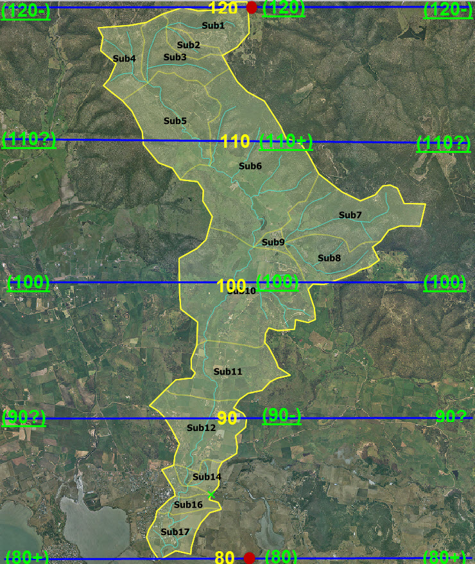
WBNM 2017--------------------------Advanced Usage
Spatial Rainfall & Rain gauge Locations
Calc_Raingauge_Weights – using Inv Dist^2 and Closest Temporal pattern
Bracketing the catchment does create the correct intensities at the gauges and halfway between - but does not create a truly linear NS gradient in the model and does create EW artefacts.
If the gradient is not linear need additional gauges at changes in gradient.
E Rigby Nov 2017

Slide 72
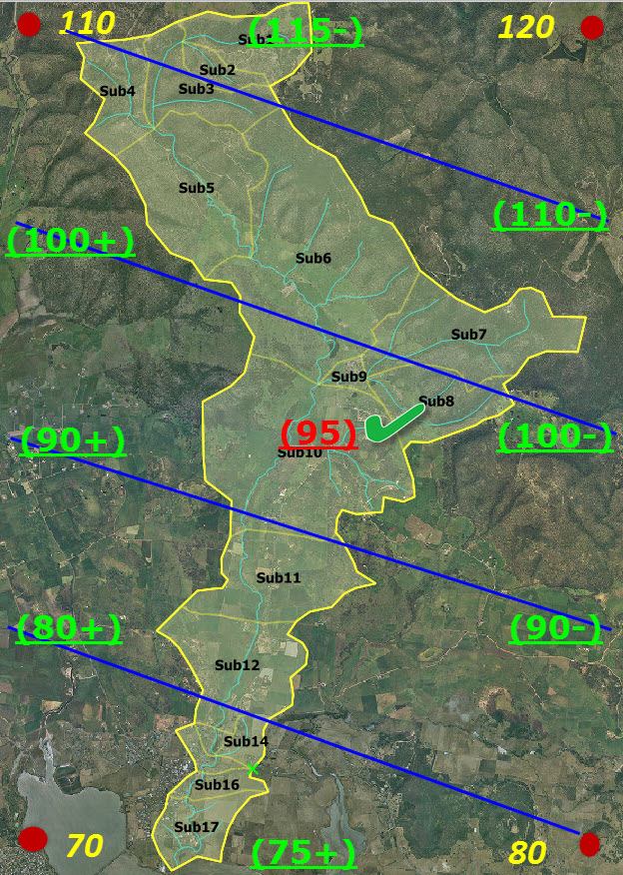
WBNM 2017--------------------------Advanced Usage
Spatial Rainfall & Rain gauge Locations
Calc_Raingauge_Weights – using Inv Dist^2 and Closest Temporal pattern
So – does fully bracketing resolve this issue?
Not quite – but does improve matters. Interpolation is a significant improvement over extrapolation! As with any contouring algorithm – the more data points the better! Often using this approach is only practical approach for large models!
Even in moderate gradient with several gauges using this method need to;
Ensure bracket catchment with design gauges and include at any gradient changes.
Ensure bracket catchment with extrapolated recording gauges if they do not already bracket catchment
Check allocated subareal intensities are distributed by this procedure as expected.
Note The design intensity surface of the appropriate AEP can help understand design rainfall pattern and guide design gauge placements. The design surface of similar AEP and daily read gauges may provide some guidance in extrapolating gauges for a significant historic event.
E Rigby Nov 2017

Slide 73
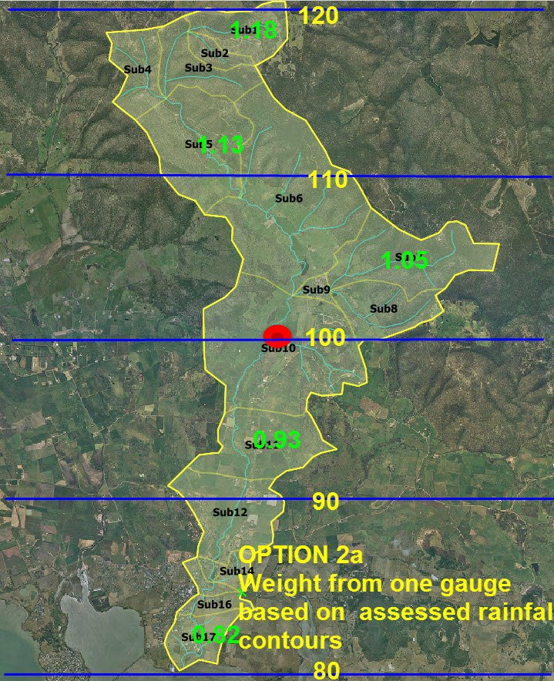
WBNM 2017--------------------------Advanced Usage
Spatial Rainfall & Rain gauge Locations
Input_Raingauge_Weights – User Weighted Avg Intensity and Closest Temporal pattern
WBNM also provides for user weighting based on multiple gauges using the temporal pattern of the nearest gauge. In a specific historic event with little shift in temporal pattern across the catchment one can use 1 gauge and factor subareal weights relative to that one gauge based on the estimated rainfall contours. This directly reflects the true rainfall on all subareas. Eg;
#####START_INPUT_RAINGAUGE_WEIGHTS
SUB1 1.18
..
SUB10 1.00
..
SUB17 0.80
#####END_INPUT_RAINGAUGE_WEIGHTS
E Rigby Nov 2017

Slide 74
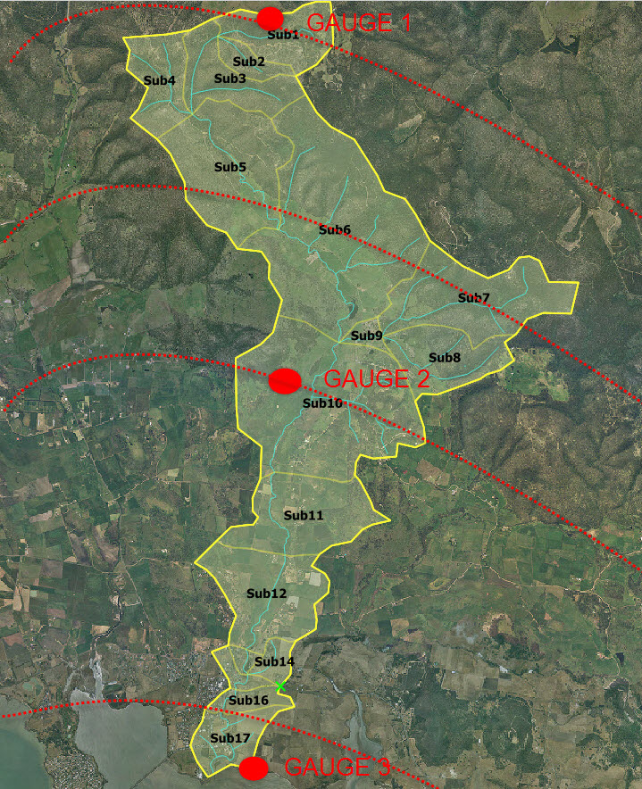
WBNM 2017--------------------------Advanced Usage
Spatial Rainfall & Rain gauge Locations
Input_Raingauge_Weights – User Weighted Avg Intensity and Closest Temporal pattern
This simplistic approach fails however when modelling a design spectrum event as there will likely be changes in surface gradients for different events in the spectrum run. It also become problematic for a historic event if there are significant differences in temporal patterns between the gauges. Have to then use multiple gauges to properly reflect these variations. Subareal weights can be assessed visually relative to adjacent gauges. Not all gauges will be necessarily used for each subarea. Time consuming for large models!
#####START_INPUT_RAINGAUGE_WEIGHTS
SUB1 1.00 0.00 0.00
….
SUB5 0.60 0.40 0.00
SUB6 0.50 0.50 0.00
SUB7 0.50 0.50 0.00
….
SUB10 0.00 1.00 0.00
SUB11 0.00 0.60 0.40
….
SUB17 0.00 0.00 1.00
#####END_INPUT_RAINGAUGE_WEIGHTS
NOTE: Spatial/temporal intensity data from radar will assist this process considerably for historic events While not yet a broadly available, standardised, data option, it will when fitted to station data, become a desirable input option for WBNM!.
E Rigby Nov 2017

Slide 75
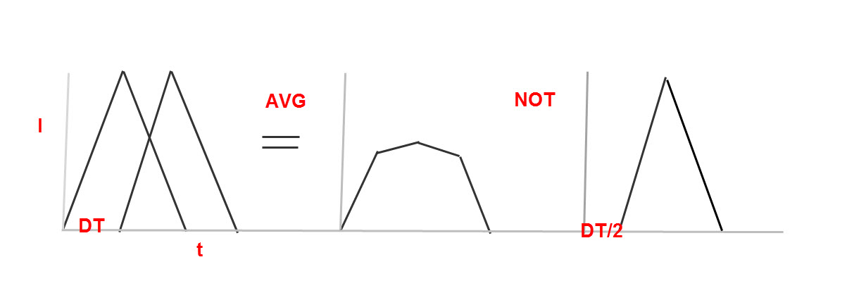
WBNM 2017--------------------------Advanced Usage
Simulating Moving Historic Storms
Historically storms rarely stationary, reasonably obvious on radar – less so from gauge records so increased interest in modelling moving storms in recent years
Always a concern as to clock sync with gauges and need at least three gauges to estimate local ground speed and direction of movement.
Can add intermediate gauges with timeshift and factored intensity along route once direction, ground speed and intensity changes established.
Always use nearest pattern for intermediate gauges– never attempt to average patterns!
E Rigby Nov 2017

Slide 76
WBNM 2017--------------------------Advanced Usage
Simulating Moving Design Storms
Not straightforward as design temporal patterns are the same for each design gauge in any particular design event. Currently, only way to simulate is to do a standard design run then save and reinput gauge hyetographs as a REC event with appropriate time shifts.
The use of a gauge time offset in the design gauge name input line is being explored to permit this to be more easily simulated in a future release. (eg)
Tasmanian_Rainfall_IFDdatabase.csv
3
SorellCkBot 0 <minutes offset start - proposal only!
SorellCkMid 5
SorellCkTop 10
E Rigby Nov 2017

Slide 77
WBNM 2017--------------------------Advanced Usage
Creating your ARR2016 rainfall.csv file
Copyright Commonwealth of Australia 2016 Bureau of Meteorology (ABN 92 637 533 532)
IFD Design Rainfall Depth (mm)
Issued:,23 March 2017
Location
Label:,SorellChTopIFD
Requested coordinate:,Easting,545888,Northing,5276088,Zone,55
Nearest grid cell:,Latitude,42.6625(S),Longitude,147.5625(E)
,,Annual Exceedance Probability (AEP)
Duration,Duration in min,63.2%,50%#,20%*,10%,5%,2%,1%
1 min,1,1.10,1.25,1.74,2.10,2.48,3.03,3.48
2 min,2,1.91,2.14,2.90,3.44,3.98,4.63,5.13
3 min,3,2.54,2.85,3.88,4.62,5.37,6.32,7.06
4 min,4,3.05,3.43,4.71,5.64,6.59,7.85,8.86
5 min,5,3.48,3.93,5.42,6.52,7.65,9.21,10.5
10 min,10,5.03,5.70,7.97,9.68,11.5,14.1,16.4
15 min,15,6.10,6.92,9.69,11.8,14.0,17.3,20.0
30 min,30,8.38,9.48,13.2,15.9,18.8,22.9,26.3
1 hour,60,11.6,13.1,17.9,21.3,24.8,29.6,33.4
2 hour,120,16.3,18.4,24.8,29.2,33.6,39.1,43.4
3 hour,180,20.2,22.7,30.5,35.8,40.8,47.3,52.1
6 hour,360,29.1,32.8,44.3,51.7,58.7,68.0,75.0
12 hour,720,41.1,46.8,64.0,75.1,85.7,101,112
24 hour,1440,55.1,63.2,88.3,105,121,144,162
48 hour,2880,68.4,78.8,112,135,157,189,214
72 hour,4320,74.6,86.0,122,148,173,209,236
96 hour,5760,78.2,90.0,128,154,181,217,246
120 hour,7200,80.7,92.8,131,158,185,221,250
144 hour,8640,82.8,95.0,134,160,186,222,251
168 hour,10080,84.6,96.9,135,161,187,222,252
< As downloaded from BOM
E Rigby Nov 2017

Slide 78
WBNM 2017--------------------------Advanced Usage
Creating your ARR2016 rainfall.csv file
#,WBNM2017 IFD file database - IFD header line and data starts after the START_DATA line ,,,,,,,,,,,,,,,,,,,,,,,,,,,,,,,,,,,,,,,,,,,,,,,,,,,,,, <Template>
#,Any text in the lines above START_DATA is ignored - NOTE all rainfall is in mm ie total rainfall over the corresponding duration.,,,,,,,,,,,
#,This file should be saved in csv format (name and extension as you wish as explicitly referenced in your wbnm2017 runfile),,,,,,,,,,,,,,,,,,,,
#,If you use spaces in the gauge name - enclose the name in quotes to confirm it is one contiguous string ,,,,,,,,,,,,,,,,,,,,,,,,,,,,,,,,,,,,,,
#,DO NOT change the format of the data header line - it is used to locate rainfall of a particular aep and dura in the gauge's row of data,,,,,,
START_DATA======================================================================================================================================
"Gauge","Easting","Northing","Zone","Downloaded","1 min 63.2","1 min 50.","1 min 20.","1 min 10.","1 min 5.","1 min 2.","1 min 1.","2 min 63.2", <etc>
SorellCkBot,545841,5261381,55,23-Mar-17,1.06,1.2,1.66,2,2.36,2.88,3.3,1.81,2.03,2.74,3.25,3.74,4.35,4.82,2.41,2.71,3.68,4.37,5.06,5.94,6.63,2.9, <etc>
SorellCkMid,548789,5270022,55,23-Mar-17,1.11,1.25,1.74,2.1,2.48,3.02,3.47,1.9,2.13,2.88,3.41,3.95,4.58,5.09,2.52,2.84,3.86,4.6,5.34,6.26,7,3.04, <etc>
SorellCkTop,545888,5276088,55,23-Mar-17,1.1,1.25,1.74,2.1,2.48,3.03,3.48,1.91,2.14,2.9,3.44,3.98,4.63,5.13,1.91,2.14,2.9,3.44,3.98,4.63,5.13,3.0 <etc>
You add the gauge data – BOM AEP columns stacked in a row using a text editor like Notepad++ or Ultra Edit
Do not use Excel – it strips the quotes from the header strings when you save as it internally stores type in xslx but csv needs them!
E Rigby Nov 2017

Slide 79
WBNM 2017--------------------------Advanced Usage
""" wbnm_IFD.py
=========================================================
This script reads the BOM IFD csv download table data
for a station and appends it to the ..IFD_database.csv
file that contains the collection of IFD datsets for
the various downloaded gauge sites.
It is configured to add the IFD data in a form compatible
with wbnm2017.
=========================================================
"""
import os
import sys
import string
csv_outfilename = 'NSW_Rainfall_IFDdatabase.csv' # change as reqd to suit region
out_fid = open(csv_outfilename, 'a') # open the ...IFDDatabase.csv out file for appending
csv_inpfilenames = []
csv_inpfilenames = ['Macriv1.csv', 'Macriv2.csv', 'Macriv3.csv', 'Macriv4.csv', 'Macriv5.csv']
for i in range(len(csv_inpfilenames)): # read in a csv BOM file
IFD_line = ''
inp_fid = open(csv_inpfilenames[i], 'r') # open the BOM IFD csv file for input
inp_lines = inp_fid.readlines() # read all station IFD matl into string list
inp_fid.close() # close the input IFD csv file
values = [] # extract what reqd from this csv
values = inp_lines[3].split(',') # split the issued line into values
downloaded = values[1].rstrip()
values = inp_lines[5].split(',') # split the station line into values
station = values[1].rstrip()
values = inp_lines[6].split(',') # split the coords line into values
easting = values[2].rstrip()
northing = values[4].rstrip()
zone = values[6].rstrip()
IFD_line = (station + ',') # populate the first few fields
IFD_line = IFD_line + (easting + ',')
IFD_line = IFD_line + (northing + ',')
IFD_line = IFD_line + (zone + ',')
IFD_line = IFD_line + (downloaded + ',')
for j in range(11, len(inp_lines)): # skip up to IFD then read IFd data
values = inp_lines[j].split(',') # split the IFD data line into values
for k in range(2, 9):
IFD_line = IFD_line + ((values[k].rstrip()) + ',') # append this lines IFD data
out_fid.write( str(IFD_line[:len(IFD_line)-1])+'\n' )
out_fid.close
print('Alldone ....’)
A python script to make creation easier!
(available in the WBNM2017/misc directory)
E Rigby Nov 2017

Slide 80
WBNM 2017--------------------------Advanced Usage
Spatial Losses
If soil types, cover or rainfall intensities vary significantly across the catchment then global losses (as is the default in ARR 2016) may be inappropriate. Typically spatial (subareal) losses are then estimated from descriptions of climate/soil type/depth/cover and occasionally from field measurement. Once the decision has been taken to reflect spatial variability in losses, all of the wbnm loss options can be considered. As most Australian loss data is now IL/CL based it is however of benefit to stay with IL/CL losses as this provides an ability to compare adopted rates with recorded data.
Do not vary losses spatially unless you have good reasons to do so!
E Rigby Nov 2017

Slide 81
WBNM 2017--------------------------Advanced Usage
Stream Improvements
Lag in a stream in a natural condition is directly simulated in wbnm when routing flows from the top to the bottom of each subarea with a stream.
When a stream is ‘improved’ (straightened-cleaned – lined) its velocity increases.
This increase in velocity can be used to estimate the reduction in the stream lag factor, (1.0 = natural) , Improved stream Lag factor = n(improved)/n(nat) <= 1.0. This assumes hydraulic radius and stream gradient are similar post improvement. If not then both R and S both may need to be included in calculating the new lag factor.
Eg n (rough natural) = say 0.070 and when straightened and concrete lined n (improved) = say 0.015, would imply a new lag factor = 0.015/0.070 = 0.21 for that stream reach.
E Rigby Nov 2017

Slide 82
WBNM 2017--------------------------Advanced Usage
Structures, Diversions & Blockages
WBNM can simulate the response of very complex structures, functioning both as local (part subarea) OSD basins and basins at the subareal outlet.
The structure can be of types – HQS, HS , HS(TWF), HS(TWR) or HS(TWC).
HQS, user specified elevs/discharges/storages
HS, inlet controlled structure
HS(TWF), inlet or outlet controlled structure with fixed tailwater
HS(TWR), inlet or outlet controlled structure with tailwater determined by provided rating curve/table
HS(TWC), inlet or outlet controlled structure with tailwater determined by normal depth flow in downstream channel for which geometry has been provided.
E Rigby Nov 2017

Slide 83
WBNM 2017--------------------------Advanced Usage
Structures, Diversions & Blockages
There can be multiple outlets of different types at each structure – BOX, PIPE, WEIR, SCOUR all with different geometries and blockges to different extents at different times. No widely used hydraulic model has this flexibility to our knowledge . When partial blockages occur at intermediate times, WBNM will therefor produce more realistic flood behaviour at such structures than its 2D hydraulic equivalents.
Flows can be diverted from these outlets to any nominated top or bottom of a subarea downstream of the structure, with a user nominated delay.
E Rigby Nov 2017

Slide 84
WBNM 2017--------------------------Advanced Usage
Structures, Diversions & Blockages (H_S & H_S_Q outlets)
#####START_OUTLET_STRUCTURE#7 < H_S Type
Basin_7 < structure name
2GA < on subarea
#####H_S < inlet controlled type
#####START_OUTLET_DETAILS
2 < 2 outlet blocks
#####WEIR
20.200 < crest elev (m)
20.000 < crest length (m)
1.700 < weir coeff
1.000 < discharge fact/time
2MB < flows to sub
TOP < location on sub
0.000 < flow delay (min)
#####PIPE
17.500 < inlet inv elev (m)
1 < number of pipes
1 < entrance type
1350.000 < diameter (mm)
0.85 37.00 < discharge fact/time
2G < flows to sub
BOTTOM < location on sub
0.000 < flow delay (min)
#####END_OUTLET_DETAILS
#####START_OUTLET_STRUCTURE#5 < H_S_Q Type
Basin_5 < structure name
4D < on subarea
#####H_S_Q < user defined discharges #####START_OUTLET_DETAILS
3 < 3 outlet blocks
#####HSQ < all must be HSQ if a HSQ structure
0.85 25.00 < discharge fact/time of blockage (min)
3G < flows to sub
BOTTOM < location on sub
5.000 < flow delay (min)
#####HSQ
1.000
4E
TOP
0.000
#####HSQ
1.000
4E
TOP
0.000
#####END_OUTLET_DETAILS
E Rigby Nov 2017

Slide 85
WBNM 2017--------------------------Advanced Usage
Structures, Diversions & Blockages (HS(TWR) outlet)
Note: If discharges exist to more than one location, then a H_Q_S type must be employed!
#####START_OUTLET_STRUCTURES_BLOCK#|######...#|###########|
1
#####START_OUTLET_STRUCTURE#1
BASIN AT OUTLET OF SUB 3 TAILWATER DEPTH FROM RATING TABLE
SUB3 < location
#####H_S(TWR)
#####START_OUTLET_DETAILS
1 < no outlet blocks
#####BOX
100.00 < invert at entrance (m)
3 < no outlets in block
1 < Entrance type
2400.00 < width (m)
1200.00 < Depth (m)
0.50 < entrance loss coeff
50.00 < Length (m)
99.50 < Outlet Invert level (m)
0.011 < Mannings n
0.85 56.00 < discharge factor/time (min)
SUB5 < discharging to
TOP < at
0.00 < delay (min)
#####END_OUTLET_DETAILS
#####START_TAILWATER_DETAILS
8 < 8 vals in rating table
99.50 0.00 < Q0 must be zero
100.10 2.00 < Elevation (m) Q (m3/sec)
100.70 8.00
101.30 9.00
101.90 29.00
102.50 48.00
103.10 69.00
103.70 95.00
#####END_TAILWATER_DETAILS
#####START_BASIN_DETAILS
12 < 12 vals in H-S table
100.00 0.00 < S0 must be zero
100.50 100.00
101.00 200.00
101.50 300.00
102.00 400.00
…….
105.50 1100.00
100.00 < starting water level (m)
0.00 < surface area (Ha)
1.00 < storage scale factor
#####END_BASIN_DETAILS
#####END_OUTLET_STRUCTURE#1
#####END_OUTLET_STRUCTURES_BLOCK###|##...##########|
E Rigby Nov 2017

Slide 86
WBNM 2017--------------------------Advanced Usage
Structures, Diversions & Blockages (HS(TWF) outlet)
Note: If discharges exist to more than one location, then a H_Q_S type must be employed!
#####START_OUTLET_STRUCTURES_BLOCK#|#####..#####|###########|
1
#####START_OUTLET_STRUCTURE#1
BASIN AT OUTLET OF SUB 3 TAILWATER DEPTH FIXED
SUB3
#####H_S(TWF)
#####START_OUTLET_DETAILS
1
#####BOX
100.00
3
1
2400.00
1200.00
0.50
50.00
99.50
0.011
1.00
SUB5
TOP
0.00
#####END_OUTLET_DETAILS
#####START_TAILWATER_DETAILS
101.50 < now fixed value
#####END_TAILWATER_DETAILS
#####START_BASIN_DETAILS
12
100.00 0.00
100.50 100.00
101.00 200.00
101.50 300.00
102.00 400.00
102.50 500.00
103.00 600.00
103.50 700.00
104.00 800.00
104.50 900.00
105.00 1000.00
105.50 1100.00
100.00
0.00
1.00
#####END_BASIN_DETAILS
#####END_OUTLET_STRUCTURE#1
#####END_OUTLET_STRUCTURES_BLOCK###|###########|###########|###########|
E Rigby Nov 2017

Slide 87
WBNM 2017--------------------------Advanced Usage
Structures, Diversions & Blockages (HS(TWC) outlet)
Note: If discharges exist to more than one location, then a H_Q_S type must be employed!
#####START_OUTLET_STRUCTURES_BLOCK#|######...####|###########|
1
#####START_OUTLET_STRUCTURE#1
BASIN AT OUTLET OF SUB 3 TAILWATER DEPTH USING MANNING IN CHNL SUB3
#####H_S(TWC)
#####START_OUTLET_DETAILS
3
#####BOX
100.00
3
1
2400.00
1200.00
0.50
50.00
99.50
0.011
1.00
SUB5
TOP
0.00
#####END_OUTLET_DETAILS
#####START_TAILWATER_DETAILS
5.00 < DS Channel Bed Width (m)
0.20 < DS Channel side slope
0.50 < DS Channel Bed slope
0.05 < DS Channel Mannings n
99.50 < DS Channel invert at structure outlet (m)
#####END_TAILWATER_DETAILS
#####START_BASIN_DETAILS
12
100.00 0.00
100.50 100.00
101.00 200.00
101.50 300.00
102.00 400.00
102.50 500.00
103.00 600.00
103.50 700.00
104.00 800.00
104.50 900.00
105.00 1000.00
105.50 1100.00
100.00
0.00
1.00
#####END_BASIN_DETAILS
#####END_OUTLET_STRUCTURE#1
#####END_OUTLET_STRUCTURES_BLOCK###|###########|###########|###########|
E Rigby Nov 2017

Slide 88
WBNM 2017--------------------------Advanced Usage
Structures, Diversions & Blockages (Basins)
In most cases basins are described by a simple elevation storage volume table and have a specified initial water level and surface area (for simulation of local rainfall onto the basin surface). A storage factor allows simple scaling of storages (up or down in volume) to facilitate design optimisation.
#####START_BASIN_DETAILS
7 < No of values in H S table
27.100 0.000 < elevation m, Storage m3E3
27.500 0.700
28.000 2.300
28.500 4.300
29.000 7.100
29.500 11.100
30.000 16.300
27.100 < starting elevation m
0.000 < surface area hectares
1.000 < storage scaling factor
#####END_BASIN_DETAILS
E Rigby Nov 2017

Slide 89
WBNM 2017--------------------------Advanced Usage
Structures, Diversions & Blockages (Basins)
Where a basin is specified in conjunction with pre-calculated discharges for each outlet (H_S_Q), the format for describing the basin is slightly different as discharges for each outlet need to be added to the table. This is more time consuming to prepare but provides an ability to describe virtually any HSQ behaviour at the structure.
#####START_BASIN_DETAILS <H_S_Q type>
9
1.370 <H 0.000 <S 0.000 <Q1 0.000 <Q2 0.000 <Q3
2.000 0.100 0.000 0.000 1.505
2.500 0.700 0.000 0.000 3.487
3.000 2.200 0.000 0.000 5.846
3.500 5.900 0.850 0.000 7.452
4.000 13.100 6.000 0.000 9.058
4.500 24.000 15.200 0.000 10.663
5.000 37.500 32.000 0.000 11.732
5.500 54.200 185.000 152.700 12.677
1.370 < starting elevation m
0.000 < Surface area hectares
1.000 < Storage scaling factor
#####END_BASIN_DETAILS
E Rigby Nov 2017

Slide 90
WBNM 2017--------------------------Advanced Usage
Within Domain Diversions
Can be as complex as required - all handled directly by wbnm !
Note: Must maintain topology such that all diversions are to topologically DS subareas. An error will be flagged if this is not the case!
#####START_OUTLET_STRUCTURE#7 < H_S Type
Basin_7 < structure name
2GA < on subarea
#####H_S < inlet controlled type
#####START_OUTLET_DETAILS
2 < 2 outlet blocks
#####WEIR
20.200 < crest elev (m)
20.000 < crest length (m)
1.700 < weir coeff
1.000 <0.00> < discharge fact/time
2MB < flows to sub
TOP < location on sub
0.000 < flow delay (min)
#####PIPE
17.500 < inlet inv elev (m)
1 < number of pipes
1 < entrance type
1350.000 < diameter (mm)
1.000 <0.00> < discharge fact/time
2G < flows to sub
BOTTOM < location on sub
0.000 < flow delay (min)
#####END_OUTLET_DETAILS
E Rigby Nov 2017

Slide 91
WBNM 2017--------------------------Advanced Usage
#####START_IMPORTED_HYDROGRAPHS
1 < No imp hyd
#####START_IMPORTED_HYDROGRAPH#1
SUB1 < inflow to
TOP < where
40 30.00 < 40vals,30min
DISCHARGE
0.00 < Qm3/sec
2.00
13.00
……etc…
3.00
2.00
1.00
1.00
0.00
#####END_IMPORTED_HYDROGRAPH#1
#####END_IMPORTED_HYDROGRAPHS
Domain Inflows
Inflows: Are simulated by adding one or more ‘imported hydrograph’(s) into the runfile, typically, but not necessarily, added at the top of the relevant boundary subarea.
E Rigby Nov 2017

Slide 92
WBNM 2017--------------------------Advanced Usage
#####START_TOPOLOGY_BLOCK##########|###########|###########|###########|
233
WollA 295926.00 6174928.00 296345.00 6175009.00 WollB
WollB 296374.00 6175275.00 296733.00 6175155.00 WollC
……………etc.
MacRivY 296092.00 6174523.00 296757.00 6174973.00 MacRivZ
MacRivZ 296465.00 6174866.00 296757.00 6174973.00 MacRiv1
AlbionB(1)A 296832.00 6174537.00 296860.00 6174414.00 AlbionB(1)B
MacRiv1 297066.00 6174889.00 297115.00 6175197.00 MacRiv2
MacRiv2 297413.00 6174881.00 297734.00 6174681.00 LakeIll
AlbionF(1)A 297614.00 6174212.00 299059.00 6174670.00 LakeIll
AlbionD(2)A 297765.00 6173618.00 297664.00 6173788.00 AlbionD(2)B
AlbionD(2)B 297610.00 6173879.00 297526.00 6174020.00 AlbionE
AlbionD(1)A 297310.00 6174470.00 297376.00 6174390.00 AlbionD(1)B
…..etc…
AlbionC(1)B 297244.00 6174162.00 297343.00 6174000.00 AlbionD
AlbionA 297017.00 6173680.00 297033.00 6173686.00 AlbionB
AlbionB 297009.00 6173906.00 297218.00 6173934.00 AlbionC
AlbionB(4)A 297515.00 6173508.00 297461.00 6173633.00 AlbionB(4)B
AlbionB(4)B 297432.00 6173634.00 297218.00 6173934.00 AlbionC
AlbionB(3)A 297243.00 6173644.00 297218.00 6173934.00 AlbionC
AlbionB(1)B 296913.00 6174161.00 297218.00 6173934.00 AlbionC
AlbionB(2)A 296986.00 6174273.00 297218.00 6173934.00 AlbionC
AlbionC 297242.00 6173938.00 297343.00 6174000.00 AlbionD
AlbionD 297429.00 6174012.00 297526.00 6174020.00 AlbionE
AlbionE 297632.00 6174017.00 297633.00 6174077.00 AlbionF
AlbionF 297682.00 6174046.00 297769.00 6174065.00 LakeIll
LakeIll 287700.00 6173900.00 287700.00 6173900.00 SINK
#####END_TOPOLOGY_BLOCK############|###########|###########|###########|
Domain Outflows
Can only be one SINK!
To simulate a number of domain outflows create a dummy subarea say ‘external’ and direct flow from the subareas diverting flows out of the model to that subarea. Add ‘external’ as a subarea at the bottom of the topology block and discharge it to SINK.
Note: In this way volumes are maintained and the PAC algorithm works as intended. WBNM flags more than a bottom SINK as a fatal error.
E Rigby Nov 2017

Slide 93
WBNM 2017--------------------------Advanced Usage
Abnormal Natural Storage (How to Identify)
Occasionally a subarea will have a great deal more storage than is reasonably provided for in a typical natural subarea. This arises for example when a broad floodplain necks down, backing up flow over a large proportion of the floodplain upstream of the neck. Embankments and bridges across a floodplain can create similar conditions, but their impact on US storage would normally be directly accommodated in the structures HSQ. WBNM’s normal allocation of lag/storage for the subarea can not directly reflect such a naturally increased lag/storage, if present. Users should visually check their model for topography that might create such circumstances. WBNM uses the standard S=KQ^m relationship to allocate ‘natural’ storage. K = CxA^0.57 and m = 1- 0.77= 0.23 unless modified by the user. ‘Natural’ storage for a subarea can be calculated once an estimate of Qpeak for that subarea has been obtained. Natural storage on the floodplain that is significantly beyond this level will need to be addressed by explicit modelling.
E Rigby Nov 2017

Slide 94
WBNM 2017--------------------------Advanced Usage
Abnormal Natural Storage (How to Model)
It is recommended that subareas where ‘abnormal’ natural storages are present are explicitly modelled as H_S_Q structures, where the H_S (basin) relationship is derived from the topology and Q from simplified hydraulic analysis. If a 2D model is available, this can greatly simplify the creation of the relationship. Depending on the flooded extent of the subarea, losses for the subject subarea should also be reduced and the watercourse Lag Factor reduced to reflect the faster flood wave propagation in the basin (or replaced with a short time shift routing).
E Rigby Nov 2017

Slide 95
WBNM 2017--------------------------Advanced Usage
Varying Subareal Boundaries (How to Identify)
Models are often applied across a range of AEP’s. At low flows the subareal boundaries can be determined by road kerbing or other minor changes in topography. At higher discharges these features may overtop, altering the subareal boundaries and catchment topology. Such conditions are normally only encountered in urban catchments, but can significantly alter flow behaviour. Users should carefully consider this issue if any subareal boundaries are not clearly defined/fixed in their model across the range of simulated discharges.
E Rigby Nov 2017

Slide 96
WBNM 2017--------------------------Advanced Usage
Varying Subareal Boundaries (How to Model)
If the change occurs at a particular flow level (AEP), it may be practical to construct two topologically different models, applying one up to the AEP transition point and the other above that point.
Alternatively, while requiring more thought, a structure can be added to the breaching subarea and a diversion added to reflect the behaviour of the higher flows. This does have the advantage that it correctly reflects the changing behaviour under all AEP/Dura/Patt rainfall and does so in the one model. In most circumstances this would be the preferred option.
E Rigby Nov 2017

Slide 97
WBNM 2017--------------------------Advanced Usage
Partial Area Checks (Why are they needed)
While the spectrum based approach considers the impact of AEP, burst duration and pattern on peak discharge across the domain, it does not consider the impact a change in ARF (for part only of the catchment) would have on the DFE a the outlet of the partial catchment, or the impact a change from areal to point temporal patterns might have on the same DFE. Initial loss may also differ. Clearly this impact is likely to be greatest when the catchment is large and the partial catchment much smaller. Differences would be further aggravated if this also involves a change from areal to point temporal patterns in the process. Our own limited testing suggests it can be significant in any catchment > 75Km2 area. (due to the switch in temporal patterns at 75km2) but it would be prudent to check on any size catchment, if internal design flows are required..
E Rigby Nov 2017

Slide 98
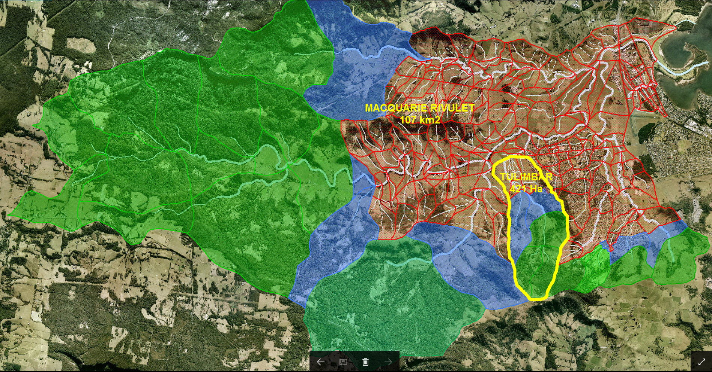
WBNM 2017--------------------------Advanced Usage
Partial Area Checks (Example)
#####START_STORM#3
1%AEP dura/patt spectrum with ARR16 losses, ARR16 ARF, PACsub = HazeE, point TP
5.00
5.00
#####START_DESIGN_RAIN_ARR2016
1 -1 -1 -1 HazeE
IFD_DATA_IN_DATABASE_FILE
NSW_Rainfall_IFDdatabase.csv
ANALYSIS OF A 1.00% DESIGN ARR 2016 STORM SPECTRUM ON Macquarie Rivulet - Shellharbour - NSW
##### WBNM - START DES16 SPECTRUM SUMMARY OF CRITICAL DURATIONS/PATTERNS FOR STORM # 3-DES16 ########
##### DES16 storm dura and pattern spectrum simulation partial area check at HazeE;
##### 1%AEP dura/patt spectrum with ARR16 losses, ARR16 ARF, PACsub = HazeE, point TP
##### Partial Area Check - Only Subareas with runnning areas < 421.51Ha included
SUBAREA CRITICAL CRITDURA CRITPATT QpeakAvg peakPatt TpeakPatt VolPatt
OUTLET EVENTUID (min) (m3/sec) (m3/sec) (min) (m3e3)
WollA 3-13-10(DES16) 720 10 3.86 4.45 330. 58.
WollB 3-13-10(DES16) 720 10 6.36 6.97 330. 100.
WollC 3-12-6(DES16) 360 6 3.62 4.21 345. 46.
...ETC...
HazeA 3-13-10(DES16) 720 10 5.88 6.61 330. 92.
HazeB 3-13-10(DES16) 720 10 16.78 17.09 335. 283.
HazeC 3-13-1(DES16) 720 1 20.19 24.38 675. 365.
HazeD 3-13-1(DES16) 720 1 27.51 33.18 675. 496.
HazeE 3-13-1(DES16) 720 1 31.56 38.38 685. 588.
HazeG(2)A 3-12-6(DES16) 360 6 0.74 1.08 345. 4.
HazeG(1)A 3-7-1(DES16) 15 1 1.61 1.72 5. 1.
....ETC....
##### WBNM - END DESIGN SPECTRUM SUMMARY OF CRITICAL RESULTS FOR STORM #############################
Full Model:
1% AEP DFE at Highway 24.5m3/sec in critical 720/3 Areal TP full model event spectrum
PAC check:
1 % AEP DFE at Highway 31.6m3/sec in critical 720/1 Point TP PAC model event spectrum
E Rigby Nov 2017

Slide 99
WBNM 2017--------------------------Advanced Usage
USING WBNM to Sanity Check a Hydraulic Model
WBNM provides flow hydrographs at subareal nodes throughout the catchment. 2D hydraulic models can also be used to create similar flow hydrographs. Construction of a detail hydrologic model can therefor offer an opportunity to sanity check a 2D model’s flows. While the different approaches will engender some differences, there should be a reasonable correlation between the two approaches or a clear reason as to what has generated the differences. (eg abnormal floodplain storage in the hydrologic model leading to lower flows below that location in the hydrologic model).
Particularly where calibration data is limited, such a comparison can help boost confidence in the simulated flows of a hydraulic model for a minimal outlay.
My personal view is that such a comparison will always be of value and should be included as good practice in all but the most trivial models.
E Rigby Nov 2017

Slide 100
WBNM 2017--------------------------Advanced Usage
USING WBNM as a Surrogate Hydraulic Model
WBNM has the ability to relate discharge to elevation at any structure. As such it can be used to establish flood hydrographs (temporal discharge and elevation) at specific locations. If the duration of overtopping of a road by more than say 300mm is the relevant question, then WBNM can be used to specifically answer that question. As previously noted, when blockage during an event is involved, It may provide a more realistic answer at that structure than most current 2D hydrodynamic models can.
BUT:
WBNM has no spatial capacity to reflect hydraulic behaviour away from the structure or to reflect complex 2D flow behaviour at the inlet or outlet.
E Rigby Nov 2017

Slide 101
WBNM 2017--------------------------Advanced Usage
Feeding an ARR 2016 DFE Hydraulic Model (Locally)
ARR 2016 has significantly added to the complexity of DFE. Peak discharges are readily calculated using WBNM , but the associated DFE hydrograph is not.
If flood behaviour only in the vicinity of the outlet is required, then;
The subareal hydrographs associated with the identified critical dura/patt at the outlet identified by WBNM could be input as nodal inflows to the hydraulic model to simulate DFE flooding at this location or;
The rainfall associated with the identified critical dura/patt could be input direct to the hydraulic model to simulate DFE flooding at this location or;
The rainfall associated with the ensemble for the identified critical duration could be input to the model and the average flood surface at the outlet adopted as the DFE surface at this location.
Even in this simplest of circumstances these different approaches can produce different flood surface levels !
E Rigby Nov 2017

Slide 102
WBNM 2017--------------------------Advanced Usage
Feeding an ARR 2016 DFE Hydraulic Model (Spatially)
More commonly, spatial flood behaviour across a significant proportion of the catchment is required.
When partial area effects are not significant, One approach might be to use WBNM to establish what duration/pattern combinations are critical in the areas of interest so that the number of hydraulic simulations can be minimised by using;
the identified critical dura/patt combinations of the hydrographs for input to the hydraulic model to establish the max DFE surface (noting that the crit dura/patt for each subarea will typically have a peak Q a little higher than the DFE??) or;
the identified critical dura/patt combinations of the rainfall for input to the hydraulic model to establish the max DFE surface (noting that this assumes that the critical patt hydrologically behaves the same as that simulated hydraulically??) or;
the identified critical duras plus full ensemble rainfall patterns for input to the hydraulic model to establish the max DFE surface from the max of the average pattern surfaces for each duration (noting this assumes that there is a strong correlation between the average peak discharge from the pattern ensemble at a subareas outlet and the average of the flood surfaces produced by the ensemble).
E Rigby Nov 2017

Slide 103
WBNM 2017--------------------------Advanced Usage
Do we need all tabulated crit dura/patterns?
ANALYSIS OF A 1.00% DESIGN ARR 2016 STORM SPECTRUM ON Sorell Creek - Sorell - Tasmania
##### WBNM - START DES16 SPECTRUM SUMMARY OF CRITICAL DURATIONS/PATTERNS FOR STORM # 2-DES16 ########
##### DES16 storm dura and pattern spectrum simulation;
##### 1% AEP Design dura/patt Spectrum -user 36/4.0 losses -ARF 1.0
##### Note -the outlet Opeakavg is the actual ARR 2016 DFE for the catchment.
##### Partial area checks may be needed to establish actual ARR 2016 DFEs
##### at other locations internal to the catchment!
SUBAREA CRITICAL CRITDURA CRITPATT QpeakAvg peakPatt TpeakPatt VolPatt
OUTLET EVENTUID (min) (m3/sec) (m3/sec) (min) (m3e3)
Sub01 2-12-4(DES16) 360 4 4.84 5.97 345. 53.
Sub02 2-12-4(DES16) 360 4 1.91 2.33 345. 16.
Sub03 2-12-4(DES16) 360 4 9.54 11.37 360. 123.
Sub04 2-12-4(DES16) 360 4 4.49 5.54 345. 48.
Sub05 2-15-10(DES16) 2880 10 18.83 18.91 1200. 642.
Sub06 2-13-5(DES16) 720 5 28.58 28.63 720. 807.
………
Sub15 2-13-5(DES16) 720 5 50.91 52.02 745. 1664.
Sub16 2-13-5(DES16) 720 5 51.08 52.15 760. 1685.
Sub17 2-13-5(DES16) 720 5 51.44 52.37 775. 1735.
##### WBNM - END DESIGN SPECTRUM SUMMARY OF CRITICAL RESULTS FOR STORM #############################
E Rigby Nov 2017

Slide 104
WBNM 2017--------------------------Advanced Usage
Do we need all tabulated crit dura/patterns?
##### WBNM - START DURATION SPECTRUM SUMMARY FOR 1.00 % AEP STORM ############### 2-DES16
##### DES16 storm dura and pattern spectrum simulation;
##### 1% AEP Design dura/patt Spectrum -user 36/4.0 losses -ARF 1.0
##### Note -the outlet max discharge is the ARR 2016 DFE for the catchment.
##### Partial area checks may be needed to establishm ARR 2016 DFEs
##### at other locations internal to the catchment!
SUBAREA 10 15 30 60 120 180 360 720 1440 2880 4320 5760 7200 8640 10080
Sub01 0.000 0.000 0.000 0.000 1.255 2.869 4.844 4.165 3.692 4.317 2.920 2.218 2.123 2.343 3.557
Sub02 0.000 0.000 0.000 0.000 0.606 1.268 1.908 1.490 1.253 1.459 0.974 0.748 0.715 0.788 1.184
Sub03 0.000 0.000 0.000 0.000 1.576 4.312 9.544 8.739 8.011 9.326 6.497 4.872 4.633 5.145 7.838
Sub04 0.000 0.000 0.000 0.000 1.181 2.684 4.493 3.830 3.378 3.952 2.669 2.027 1.940 2.140 3.252
Sub05 0.000 0.000 0.000 0.000 2.437 6.802 17.339 18.182 17.092 18.825 13.943 10.151 9.481 10.348 15.958
Sub06 0.000 0.000 0.000 0.000 2.886 8.091 22.243 28.584 26.856 27.653 21.460 14.855 13.874 14.273 22.782
…………
Sub15 1.805 1.788 1.976 1.980 4.573 12.969 35.717 50.915 47.928 48.405 37.171 24.626 22.982 23.355 38.590
Sub16 2.037 1.980 1.955 1.865 4.560 12.932 35.637 51.080 48.160 48.510 37.286 24.664 23.012 23.379 38.673
##### WBNM - END DURATION SPECTRUM SUMMARY FOR 1.00 % AEP STORM ###########################
720 min dura Qp only 3.5% different to 2880 min dura?
E Rigby Nov 2017

Slide 105

WBNM 2017--------------------------Advanced Usage
Feeding an ARR 2016 DFE Hydraulic Model (Spatially)
The preceding options look to present a useful means
of reducing the required hydraulic model runs – but;
The crit duration and pattern varies from subarea to subarea. Hydraulically modelling all crit duras with all crit patterns will include, for some subareas, patterns that are not the combination producing the DFE in that subarea (could be producing flows more or less than the DFE – cannot just take MAX).
While wbnm can certainly be used to restrict the range of durations to be modelled, it can not be used to restrict the patterns applied. Only option c (crit duras + full pattern ensemble) applied hydraulically avoids this problem.
E Rigby Nov 2017

Slide 106
WBNM 2017--------------------------Advanced Usage
Feeding an ARR 2016 DFE Hydraulic Model (Spatially)
There is currently no guidance on these matters in ARR 2016!
Where partial area effects are minimal;
Suggest? use wbnm to establish crit durations for each subarea of interest and for each crit dura input rainfall pattern ensemble to hydraulic model to obtain the DFE surface from the max of the average pattern surfaces for each crit duration.
Where partial area effects and ARF changes are significant ;
There is no obvious procedure for handling this additional complication at this time. Good luck!!!!!!!!
E Rigby Nov 2017

Slide 107
WBNM 2017--------------------------Advanced Usage
Feeding an ARR 2016 DFE Hydraulic Model (Spatially)
It is important to note that all discussion to date has been in regard to modelling peak flows and peak flood surfaces!
Modelling will frequently have different objectives, such as;
Duration of overtopping of roads in a specific AEP design event
Time at which a particular flood level is reached in a specific AEP design event
Peak hazard level and duration above a particular level in a specific AEP design event
Peak flood levels in areas impacted by varying DS conditions (eg tide).
As with catchments subjected to significant partial area effects, there is no guidance in ARR 2016 on these matters at this time. They are however not uncommon scenarios that need to be addressed by ARR 2016 – sooner rather than later!
E Rigby Nov 2017

Slide 108
WBNM 2017-----------------------------------------------------
E Rigby Nov 2017

Slide 109
WBNM 2017--- Support/FutureDevelopment
for support and user Q and A go to www.wbnm.com.au!
Future Development Under Consideration (in no particular order)
Release of full non beta in early new year
Fine tuning & extensions generally based on user feedback on desirable extensions
Addition of MC functionality
Modifying DFE hydrograph to be closest > 0.95 DFE instead of >=1.0 DFE?
Documenting ‘natural’ peak storage calculated for each subarea?
Extending coverage as BOM/HUB data is extended
Graphic pre and post processing of runfile and results?
Radar rainfall input/interpolation?
Gauge timeshift input for moving design storms?
Various utilities to facilitate downloading and IFD database creation?
GIS interoperability (QGIS plugin)?
E Rigby Nov 2017

Slide 110
WBNM 2017--------------------------------Open Forum
ted.rigby@rienco.com.au
????????
Thank you for attending!
E Rigby Nov 2017

